Slide 3
Plan for today
Fitting DoG to RFs
Color RFs findings:
a) Directly looking at color RFs is unreliable
b) Near absence of –S RFs
c) S inputs have larger centers, and therefore weaker surrounds
Parametrized vs unparametrized mosaics
Does reducing LR at plateau improve mosaics

Slide 4
Fitting DoGs to RFs

Slide 5
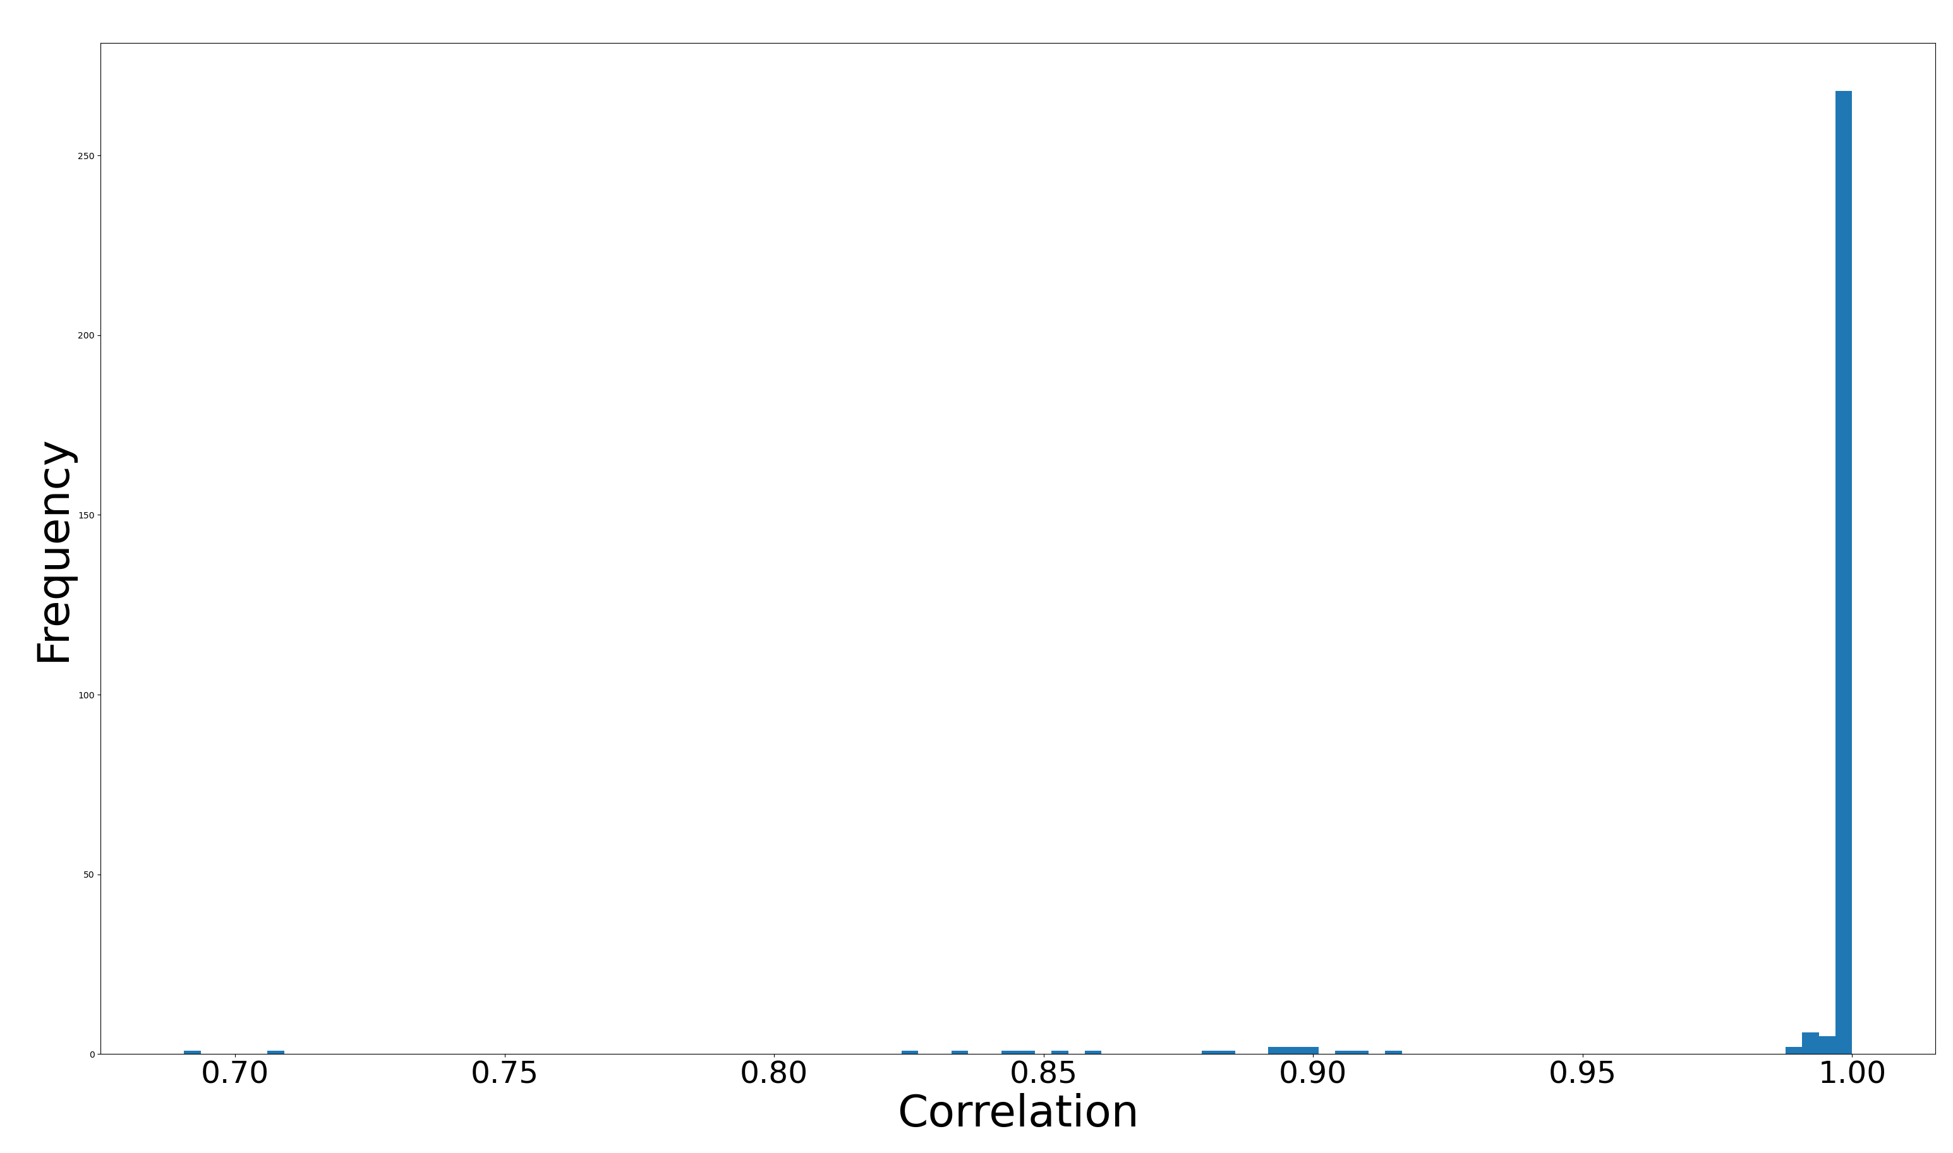
DoG fit to parametrized RFs

Slide 6
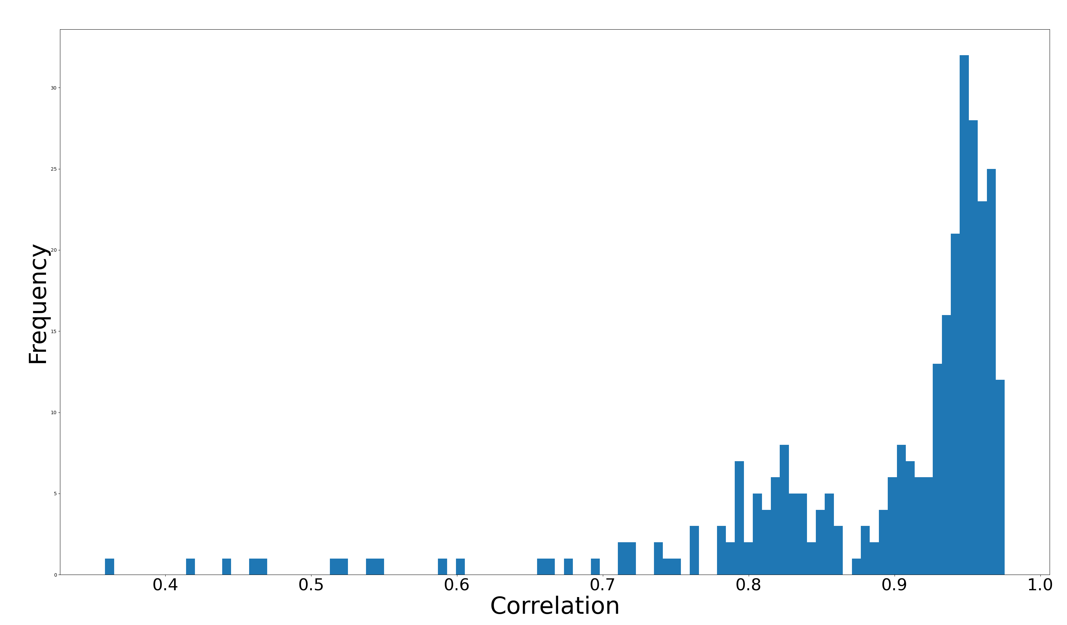
DoG fit to unparametrized RFs

Slide 7
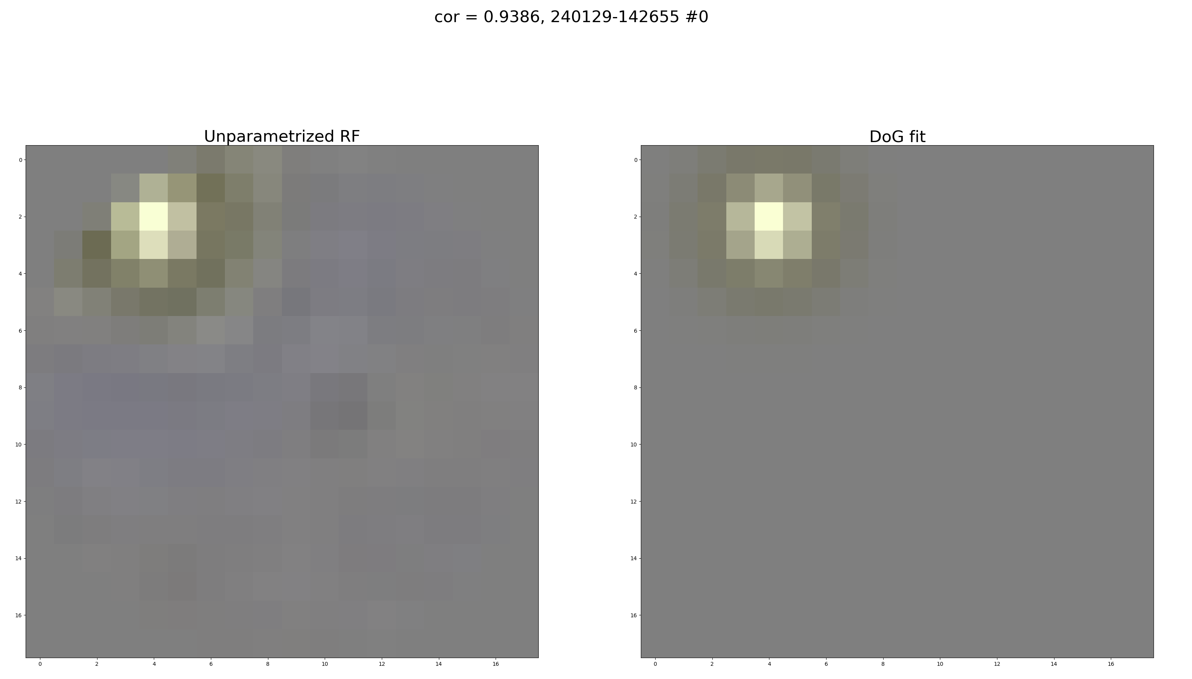

Slide 8
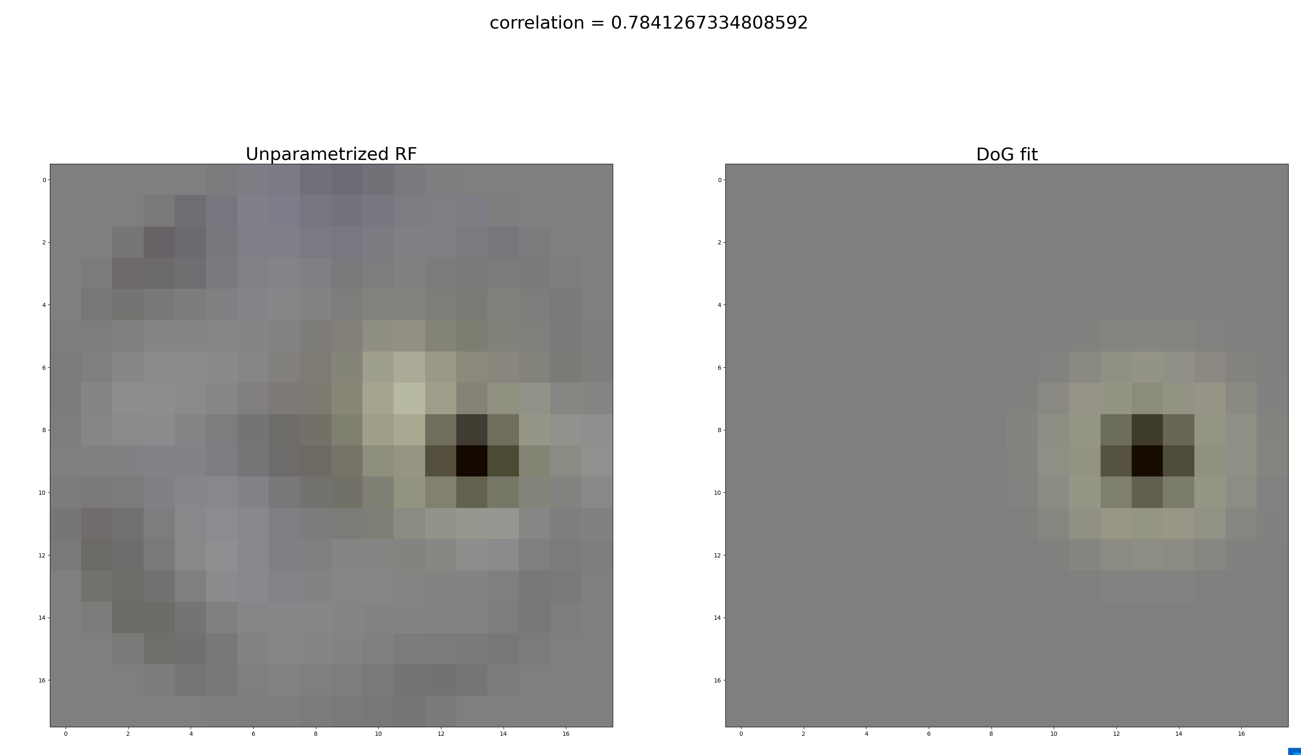

Slide 9
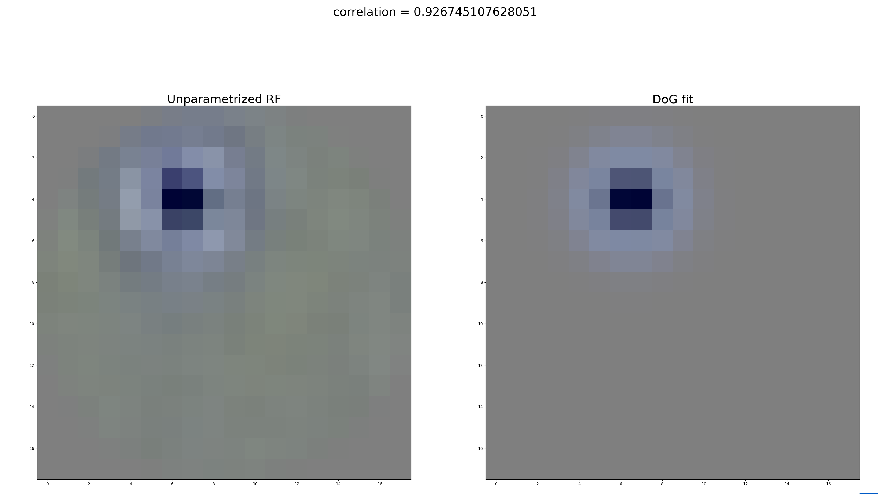

Slide 10
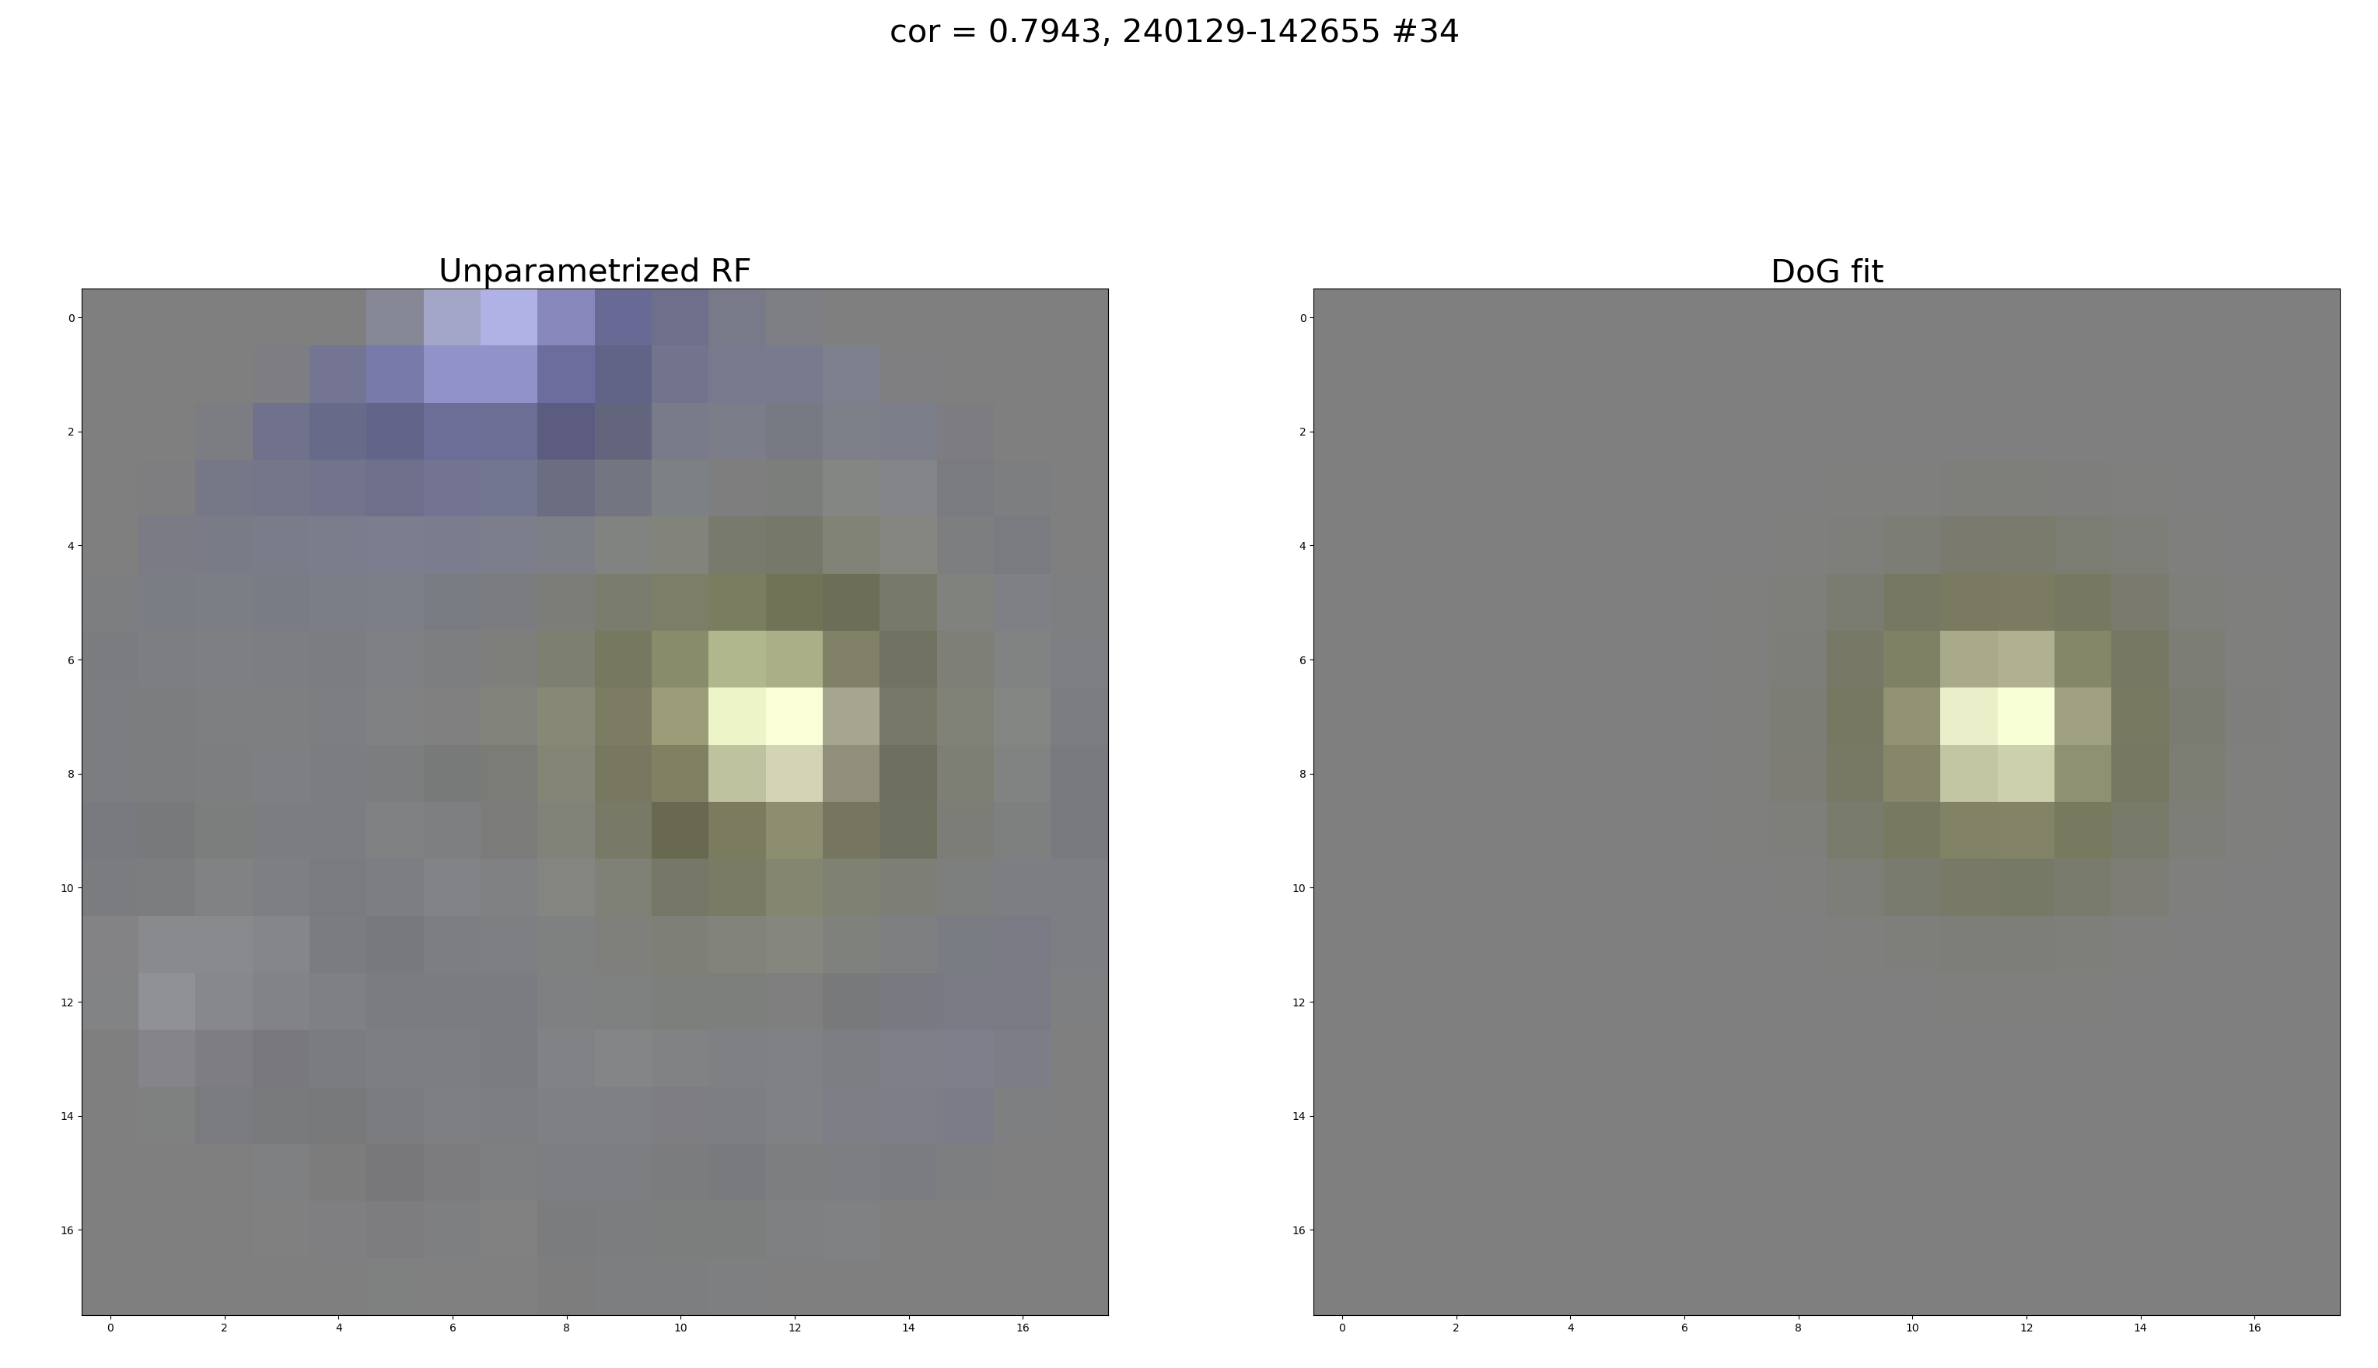

Slide 11
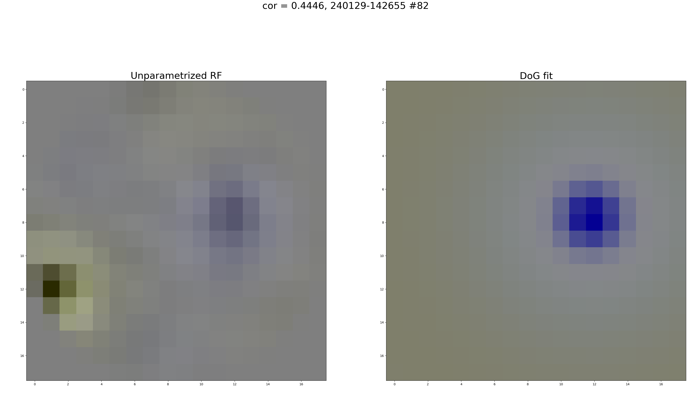

Slide 12
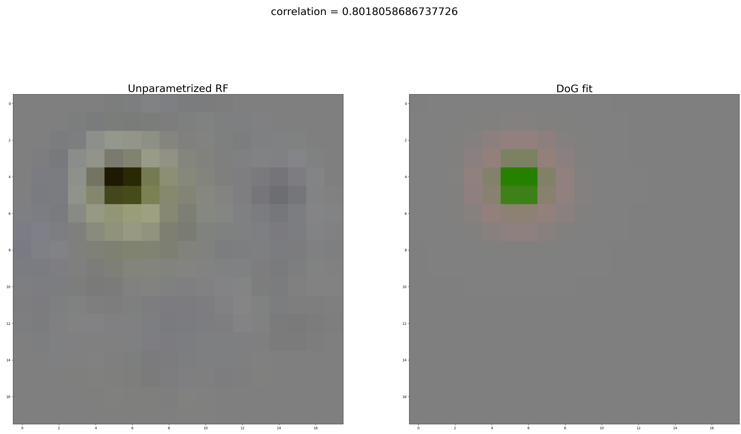

Slide 13
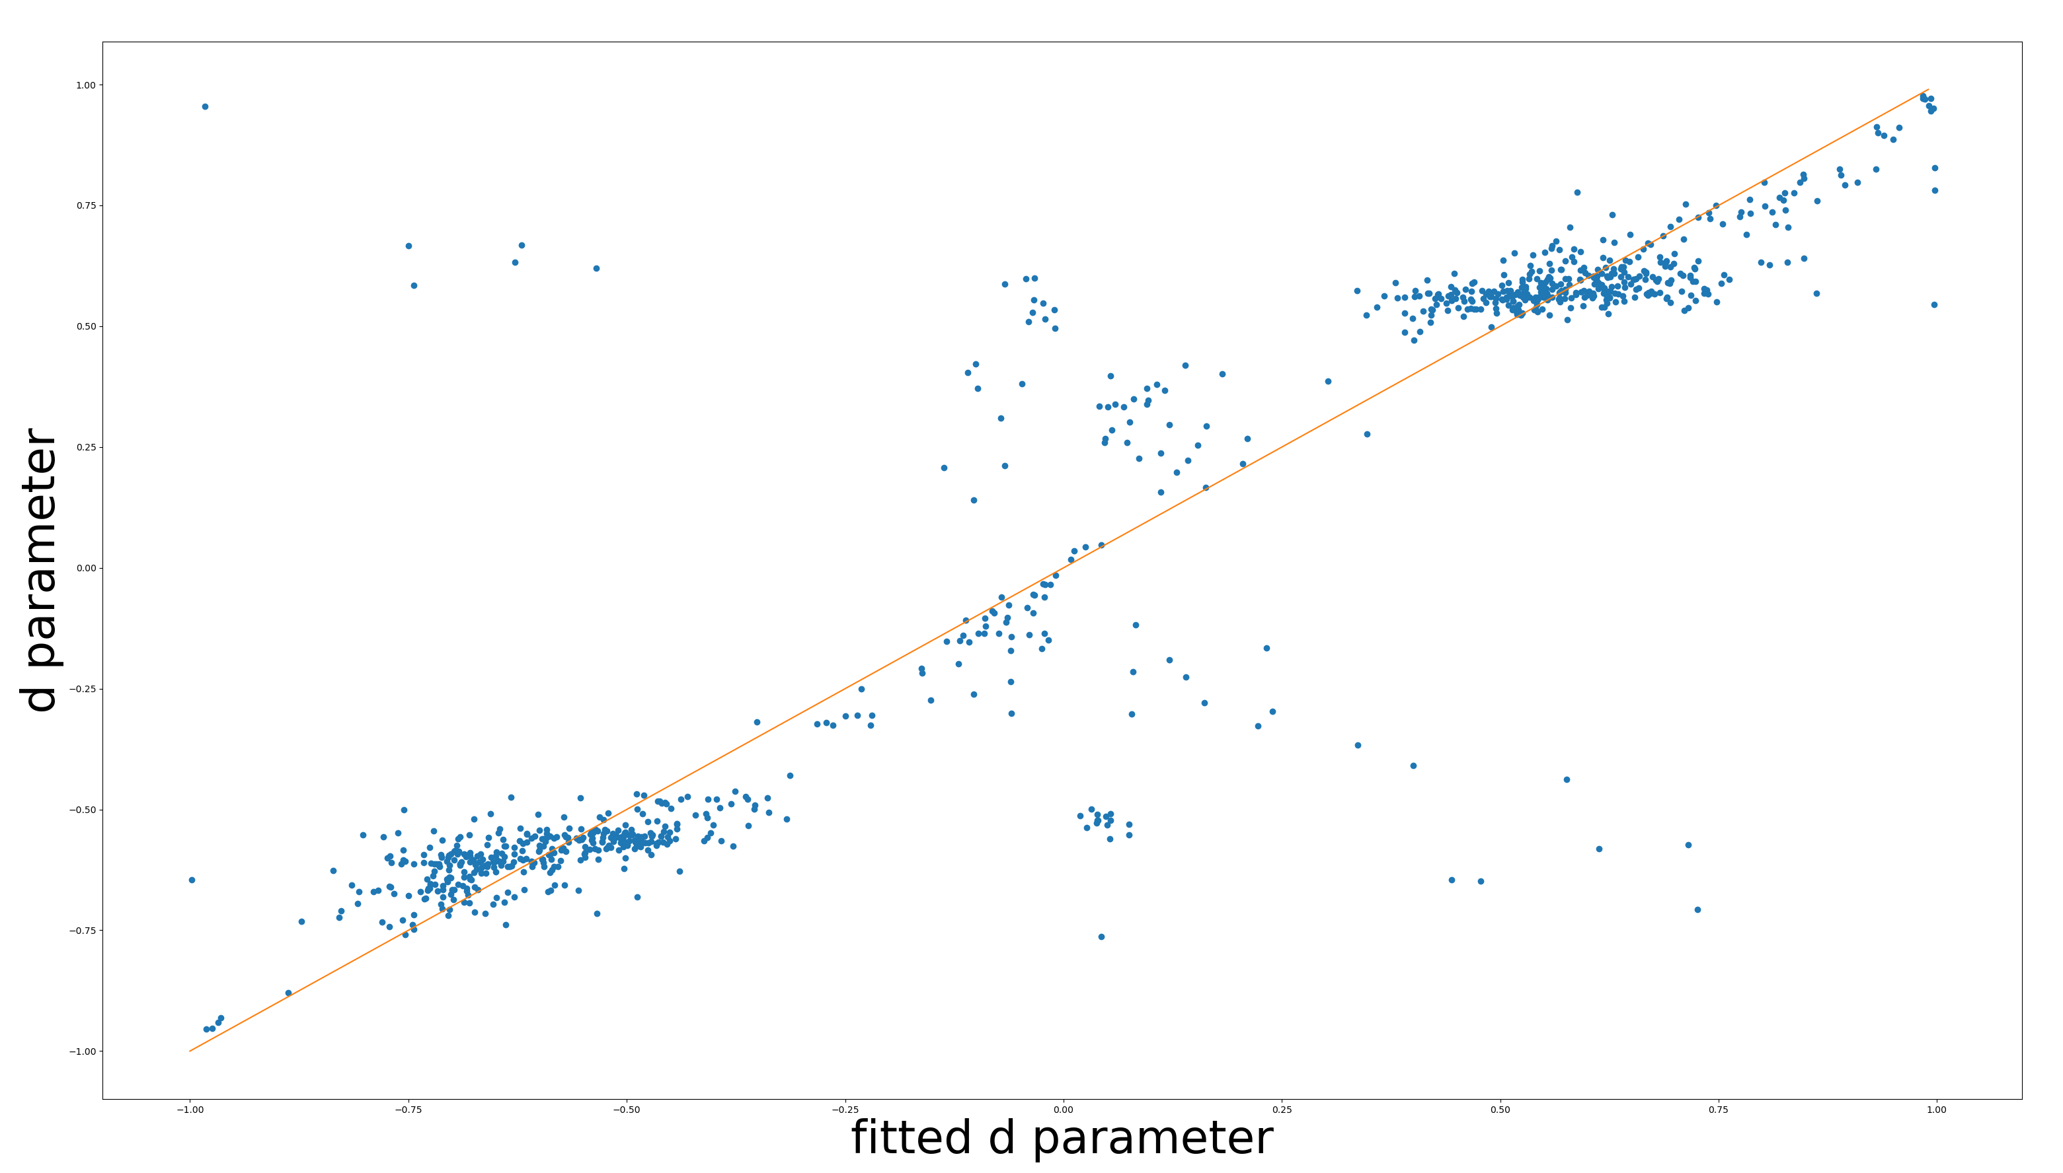

Slide 14
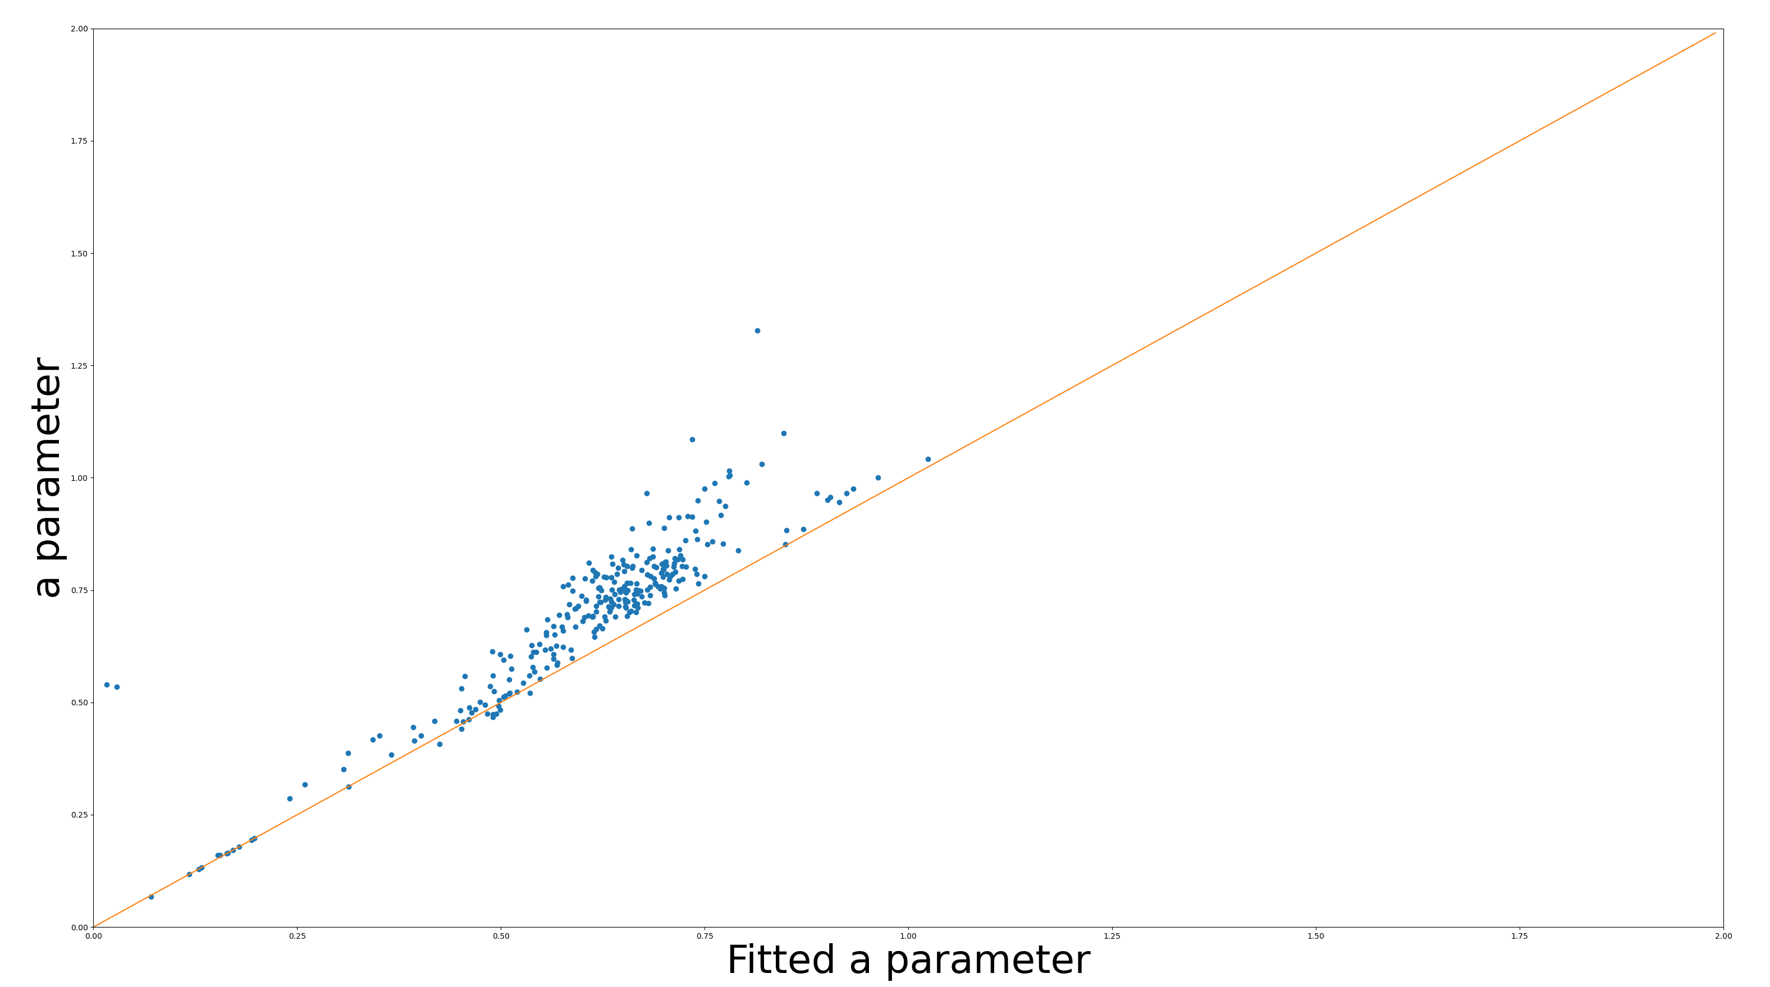
Only the most important channel

Slide 15
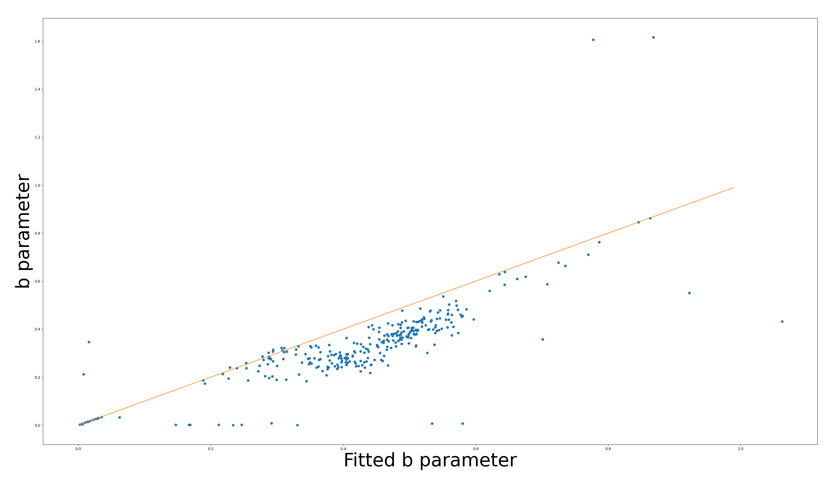
Only the most important channel

Slide 16
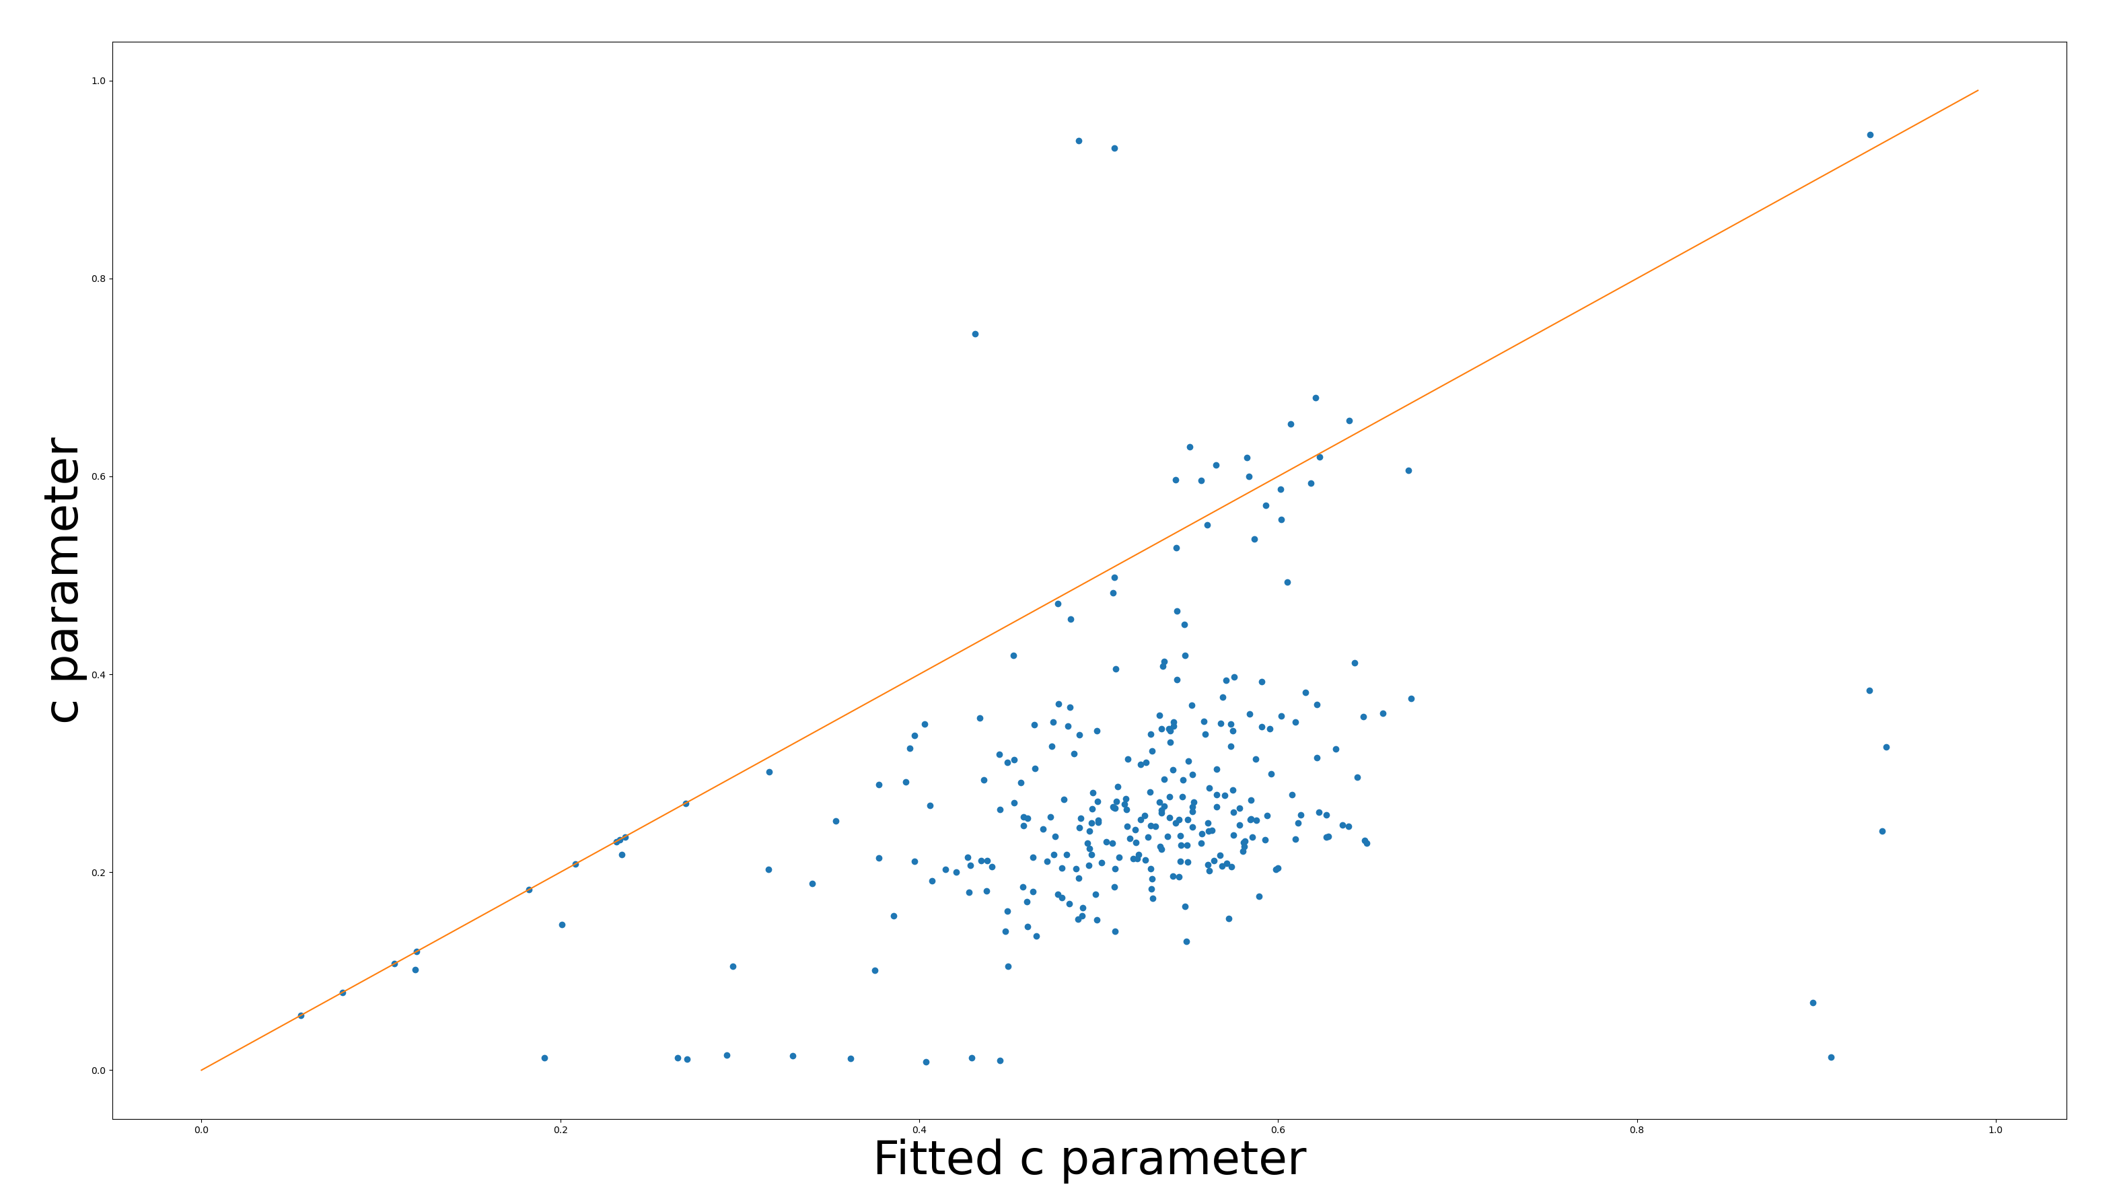
Only the most important channel

Slide 17
Color RFs
Directly looking at color RFs is unreliable
Near absence of –S RFs
S inputs have much weaker surrounds

Slide 18
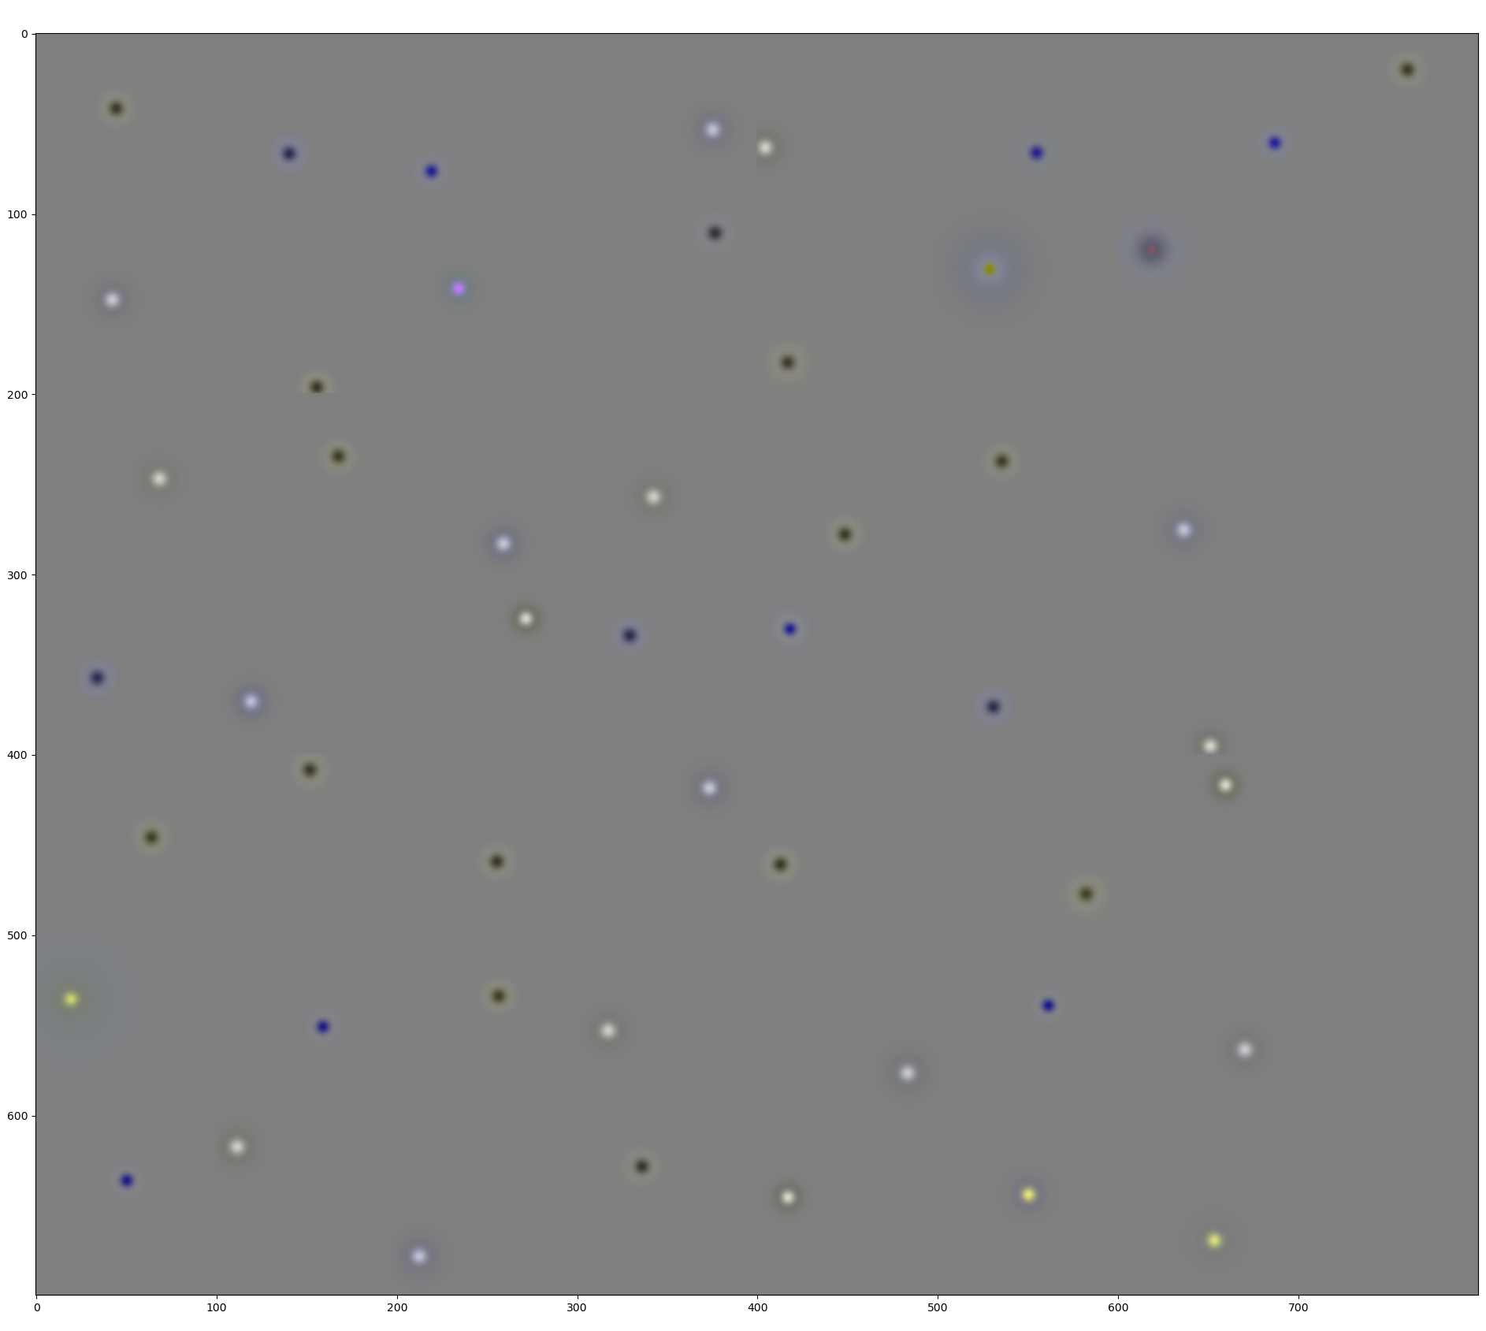
Looking at colors is unreliable

Slide 19
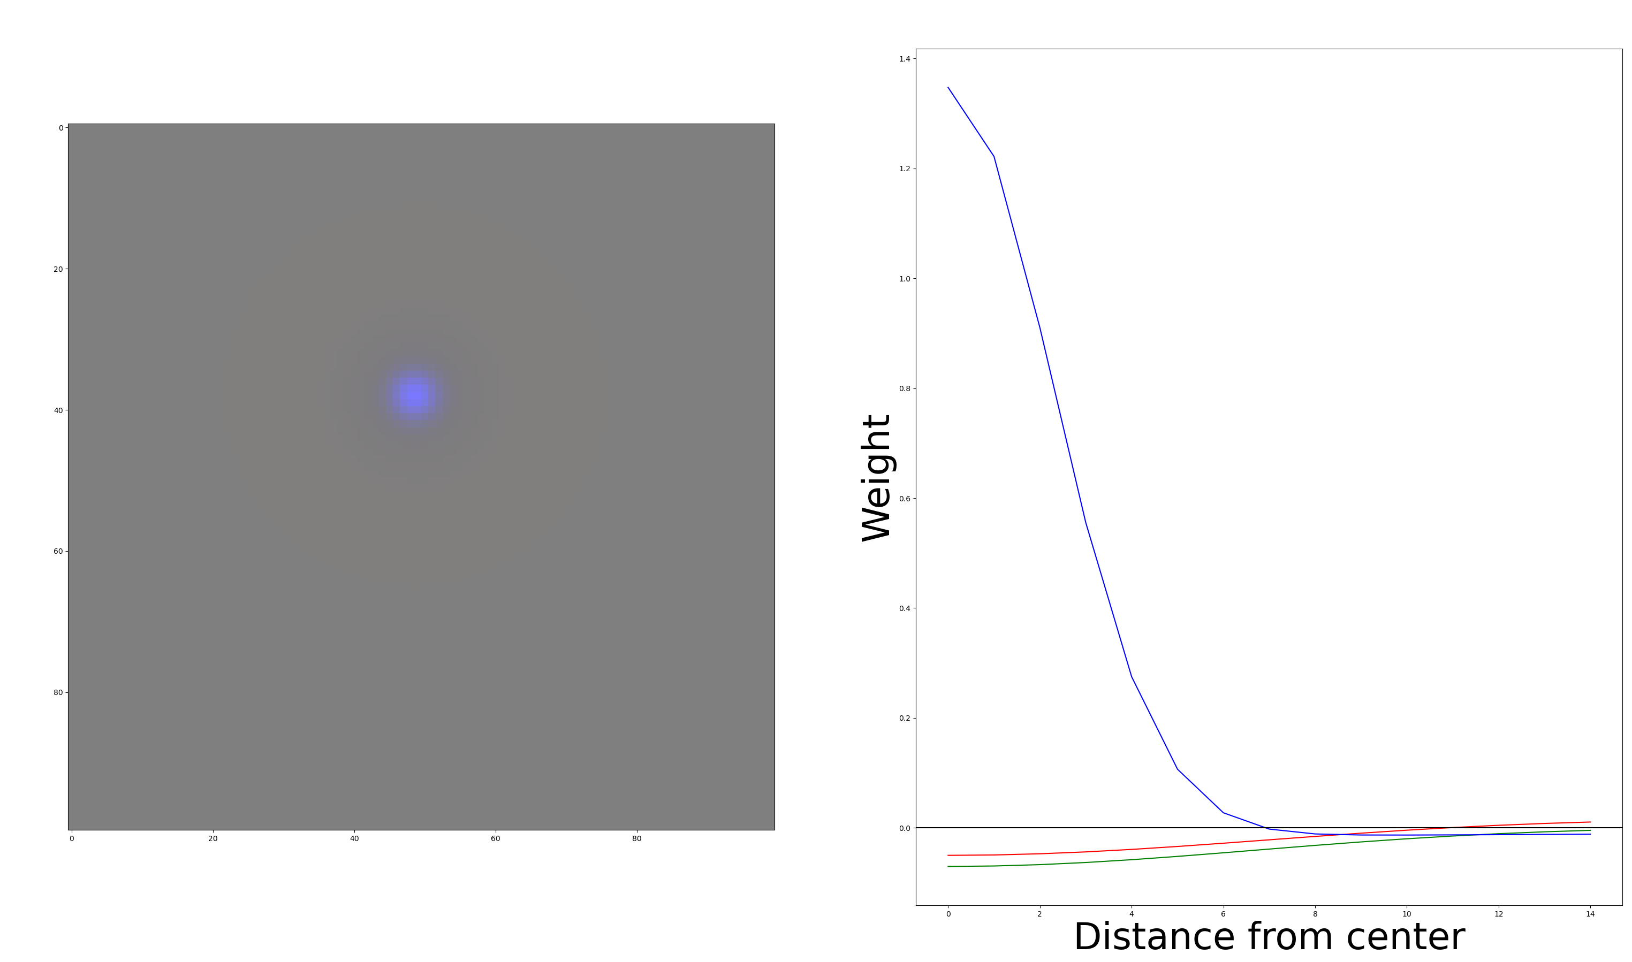
That’s what you would expect a “blue” RF to look like:

Slide 20
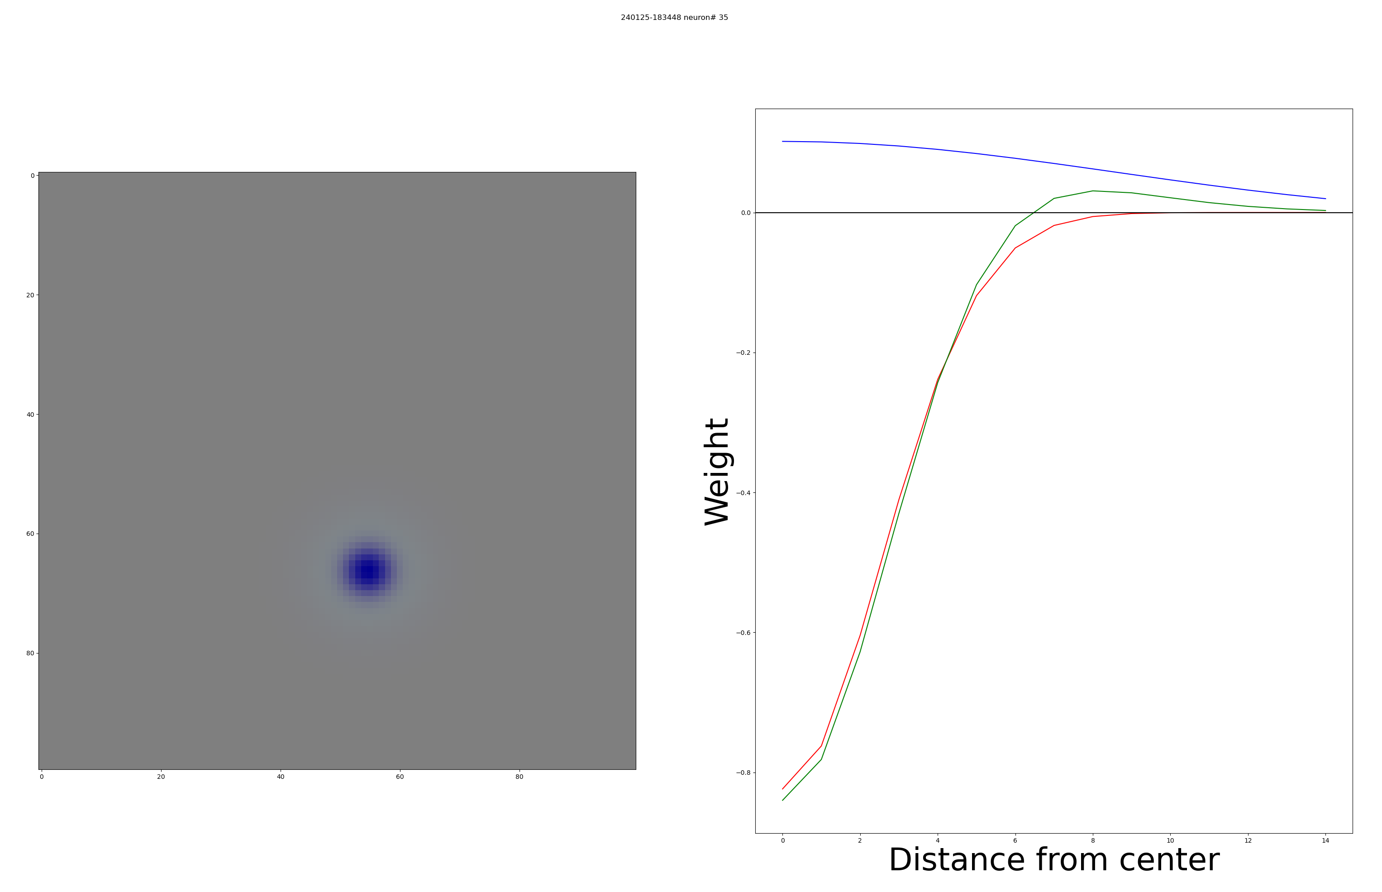
But most “blue” RFs look like this:

Slide 21
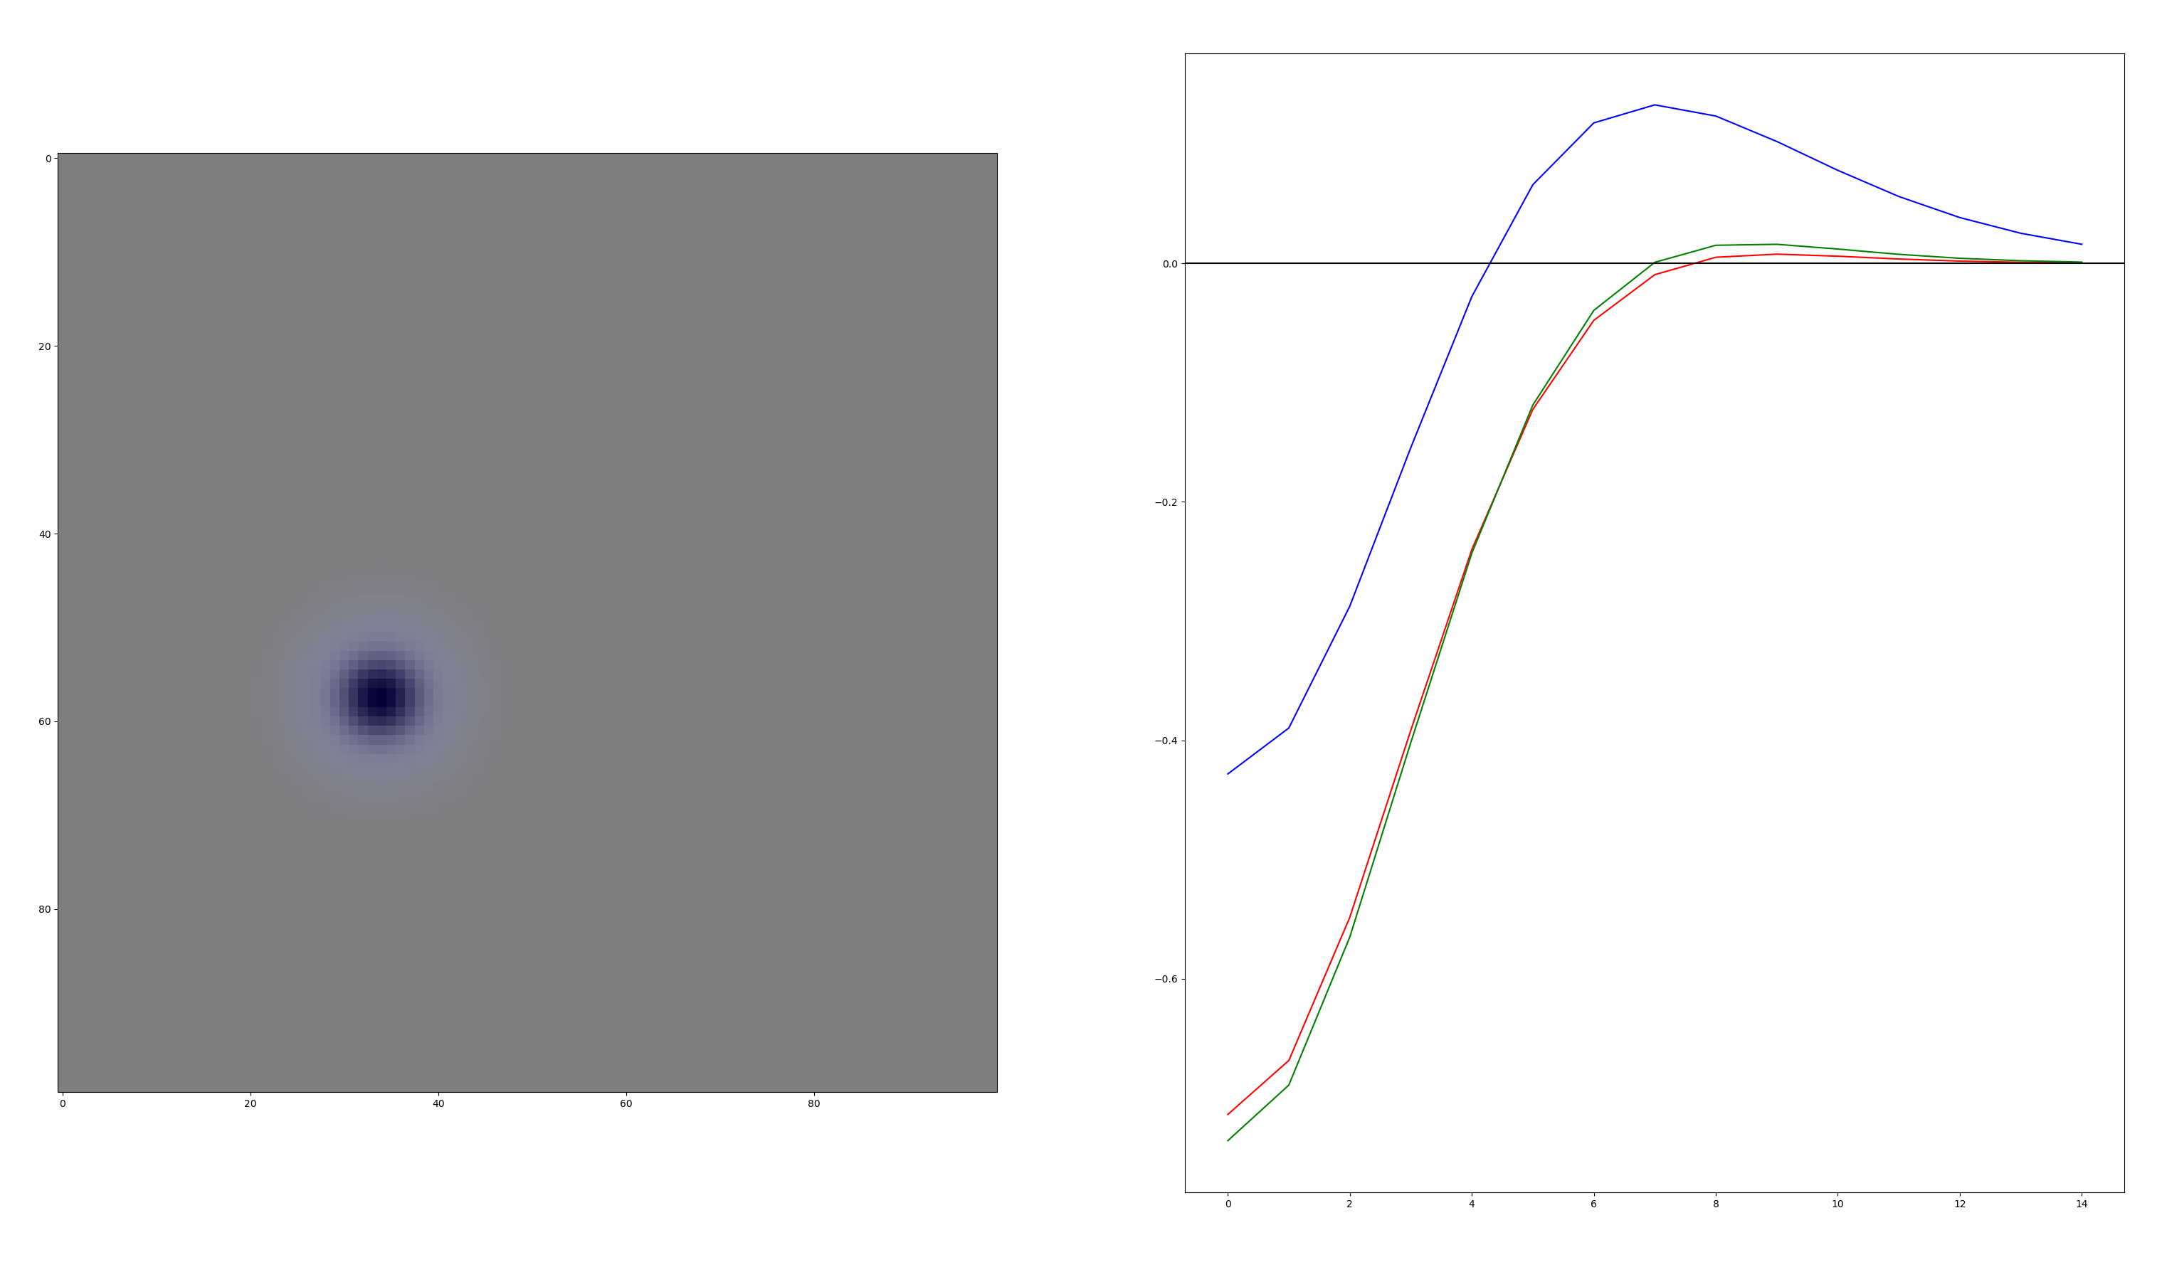
Or even this:

Slide 22
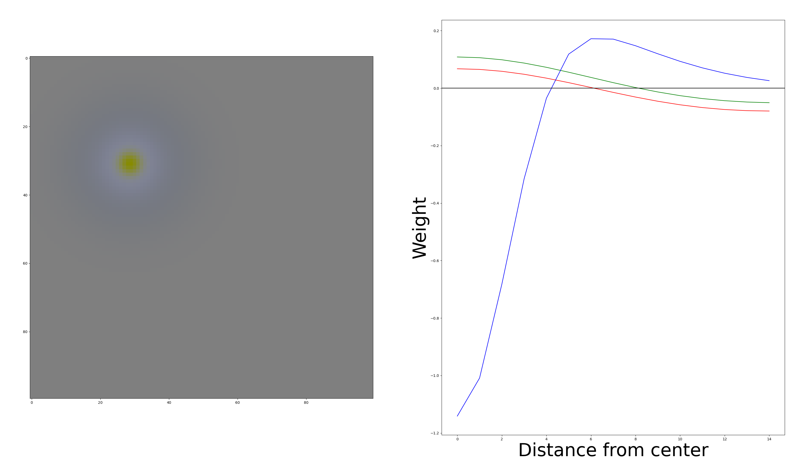
We get only 2 –S RFs: Hypothesis: These might disappear if we get closer to global minimum

Slide 23
What RFs are in each mosaic?
Or how many koniocellular RFs do we get
And are mosaics real

Slide 24
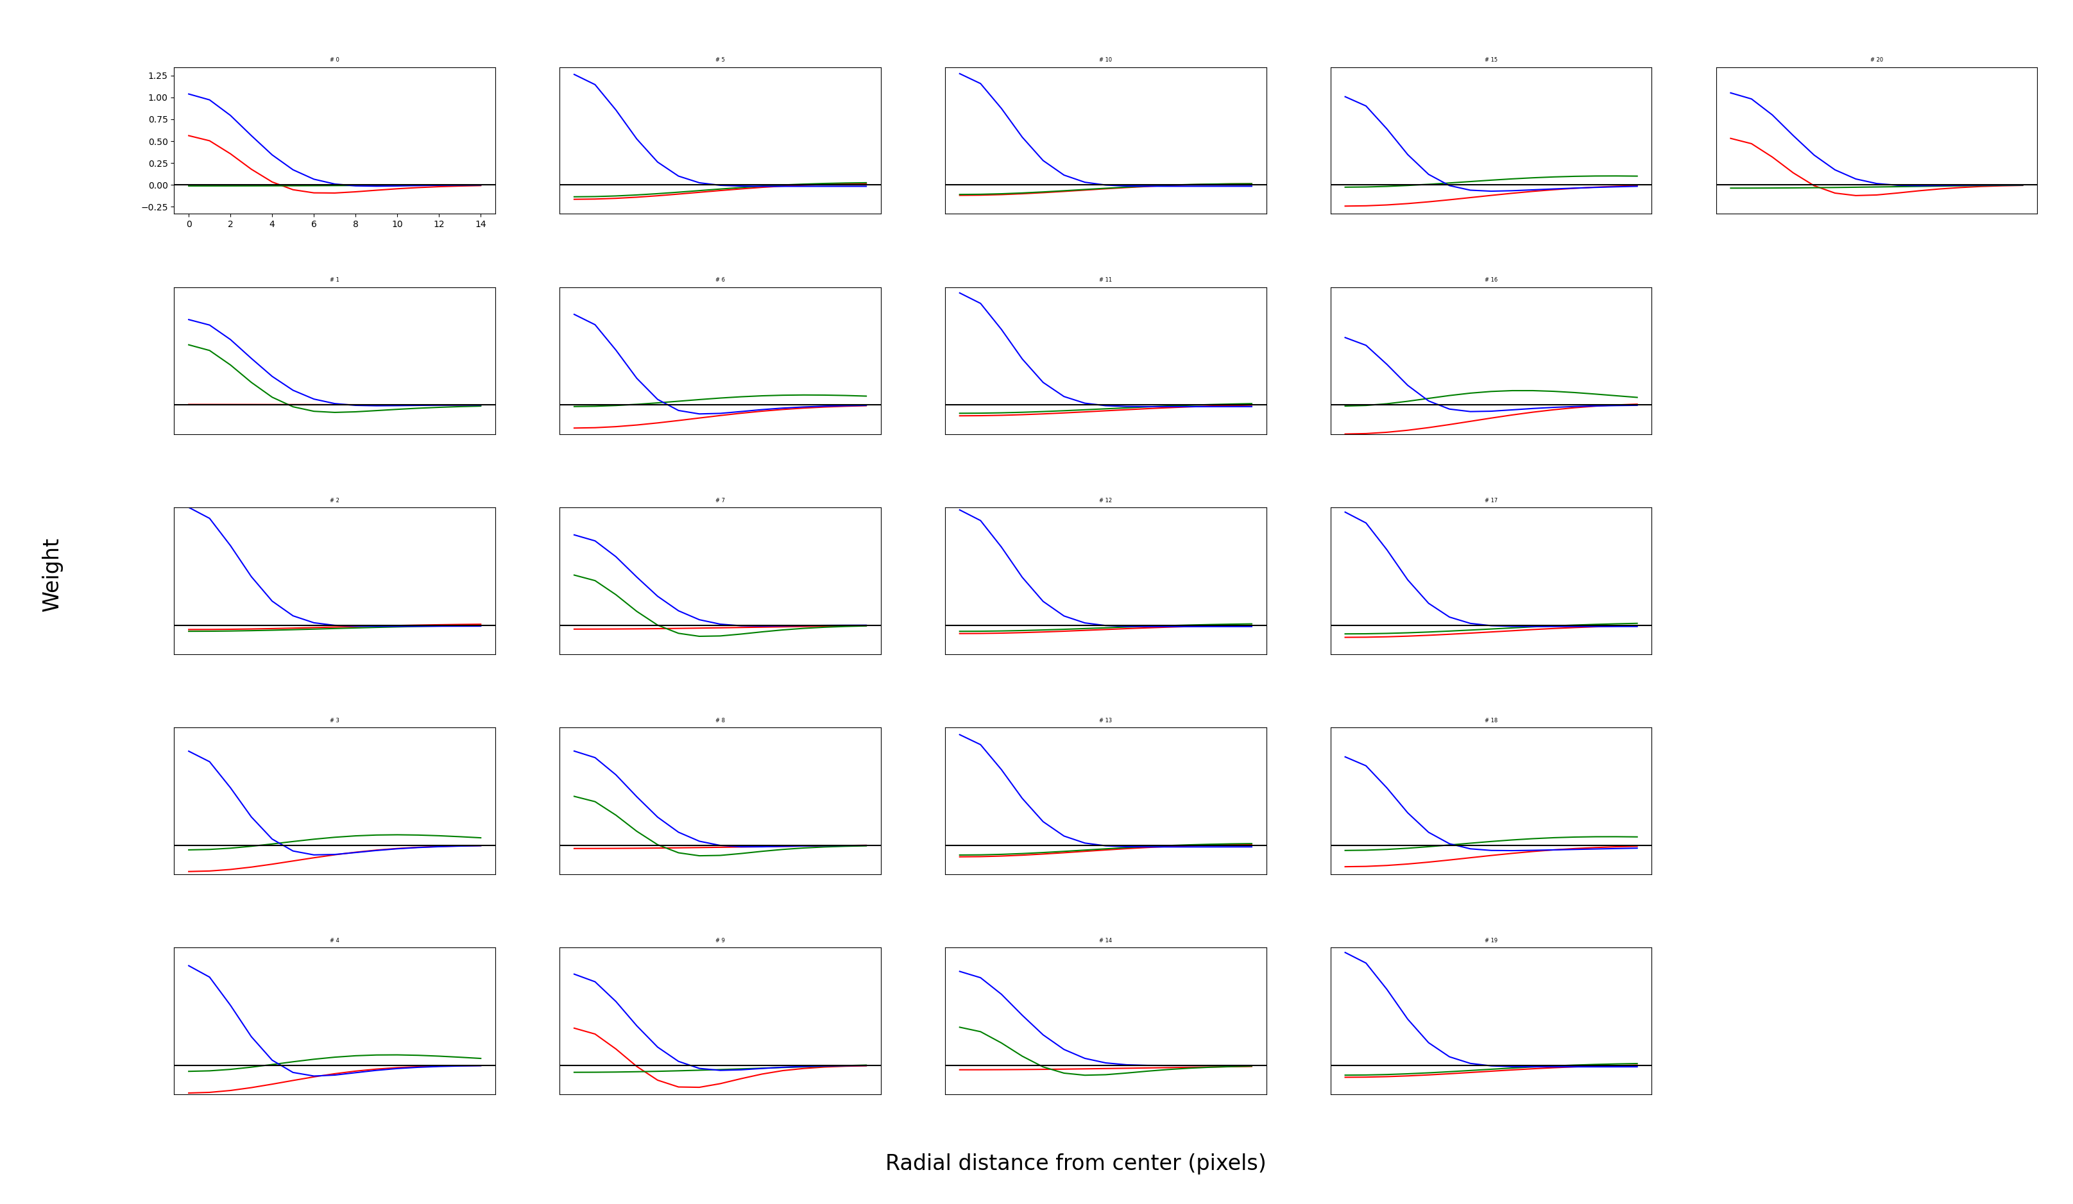
First type (Konio)

Slide 25
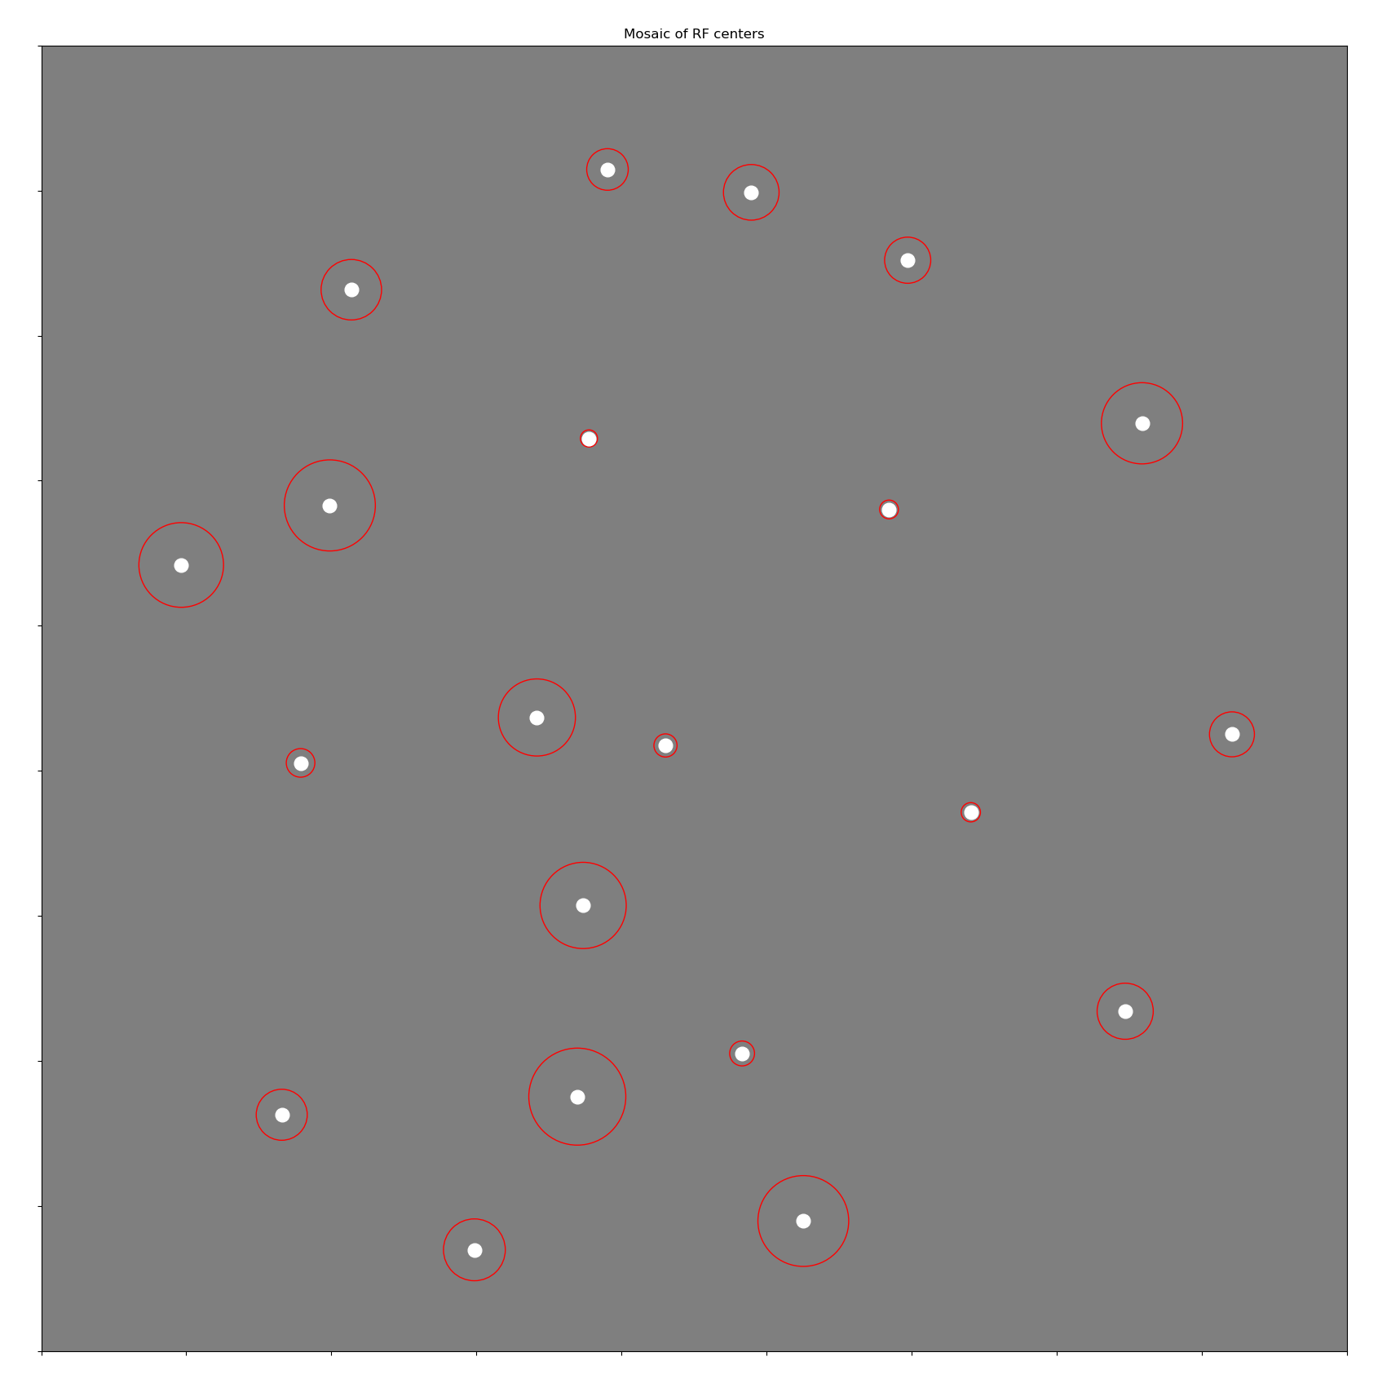
First type (Konio)

Slide 26
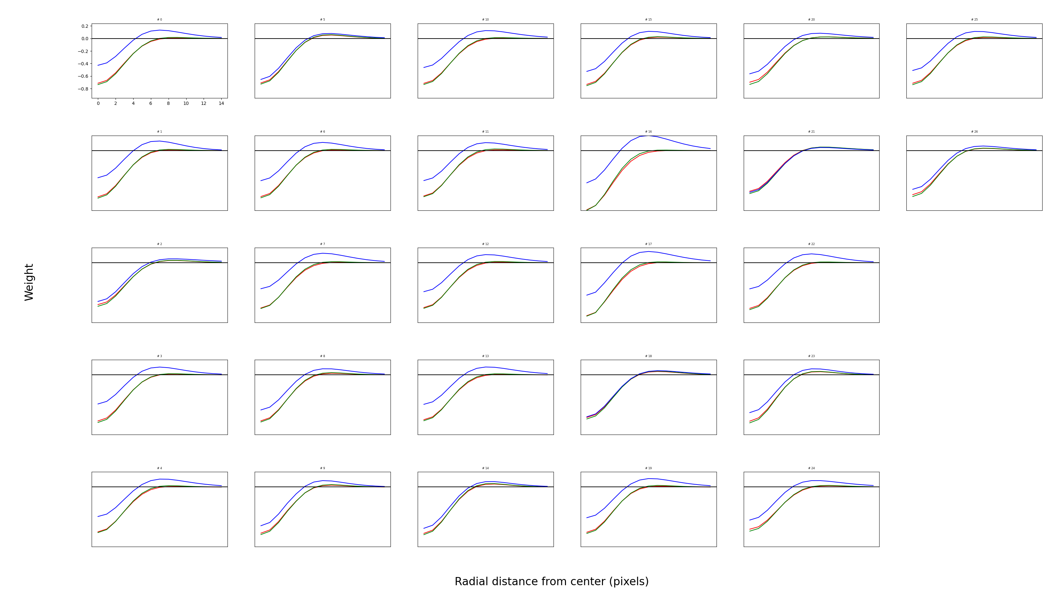
Second type (OFF parvo with –S inputs?)

Slide 27
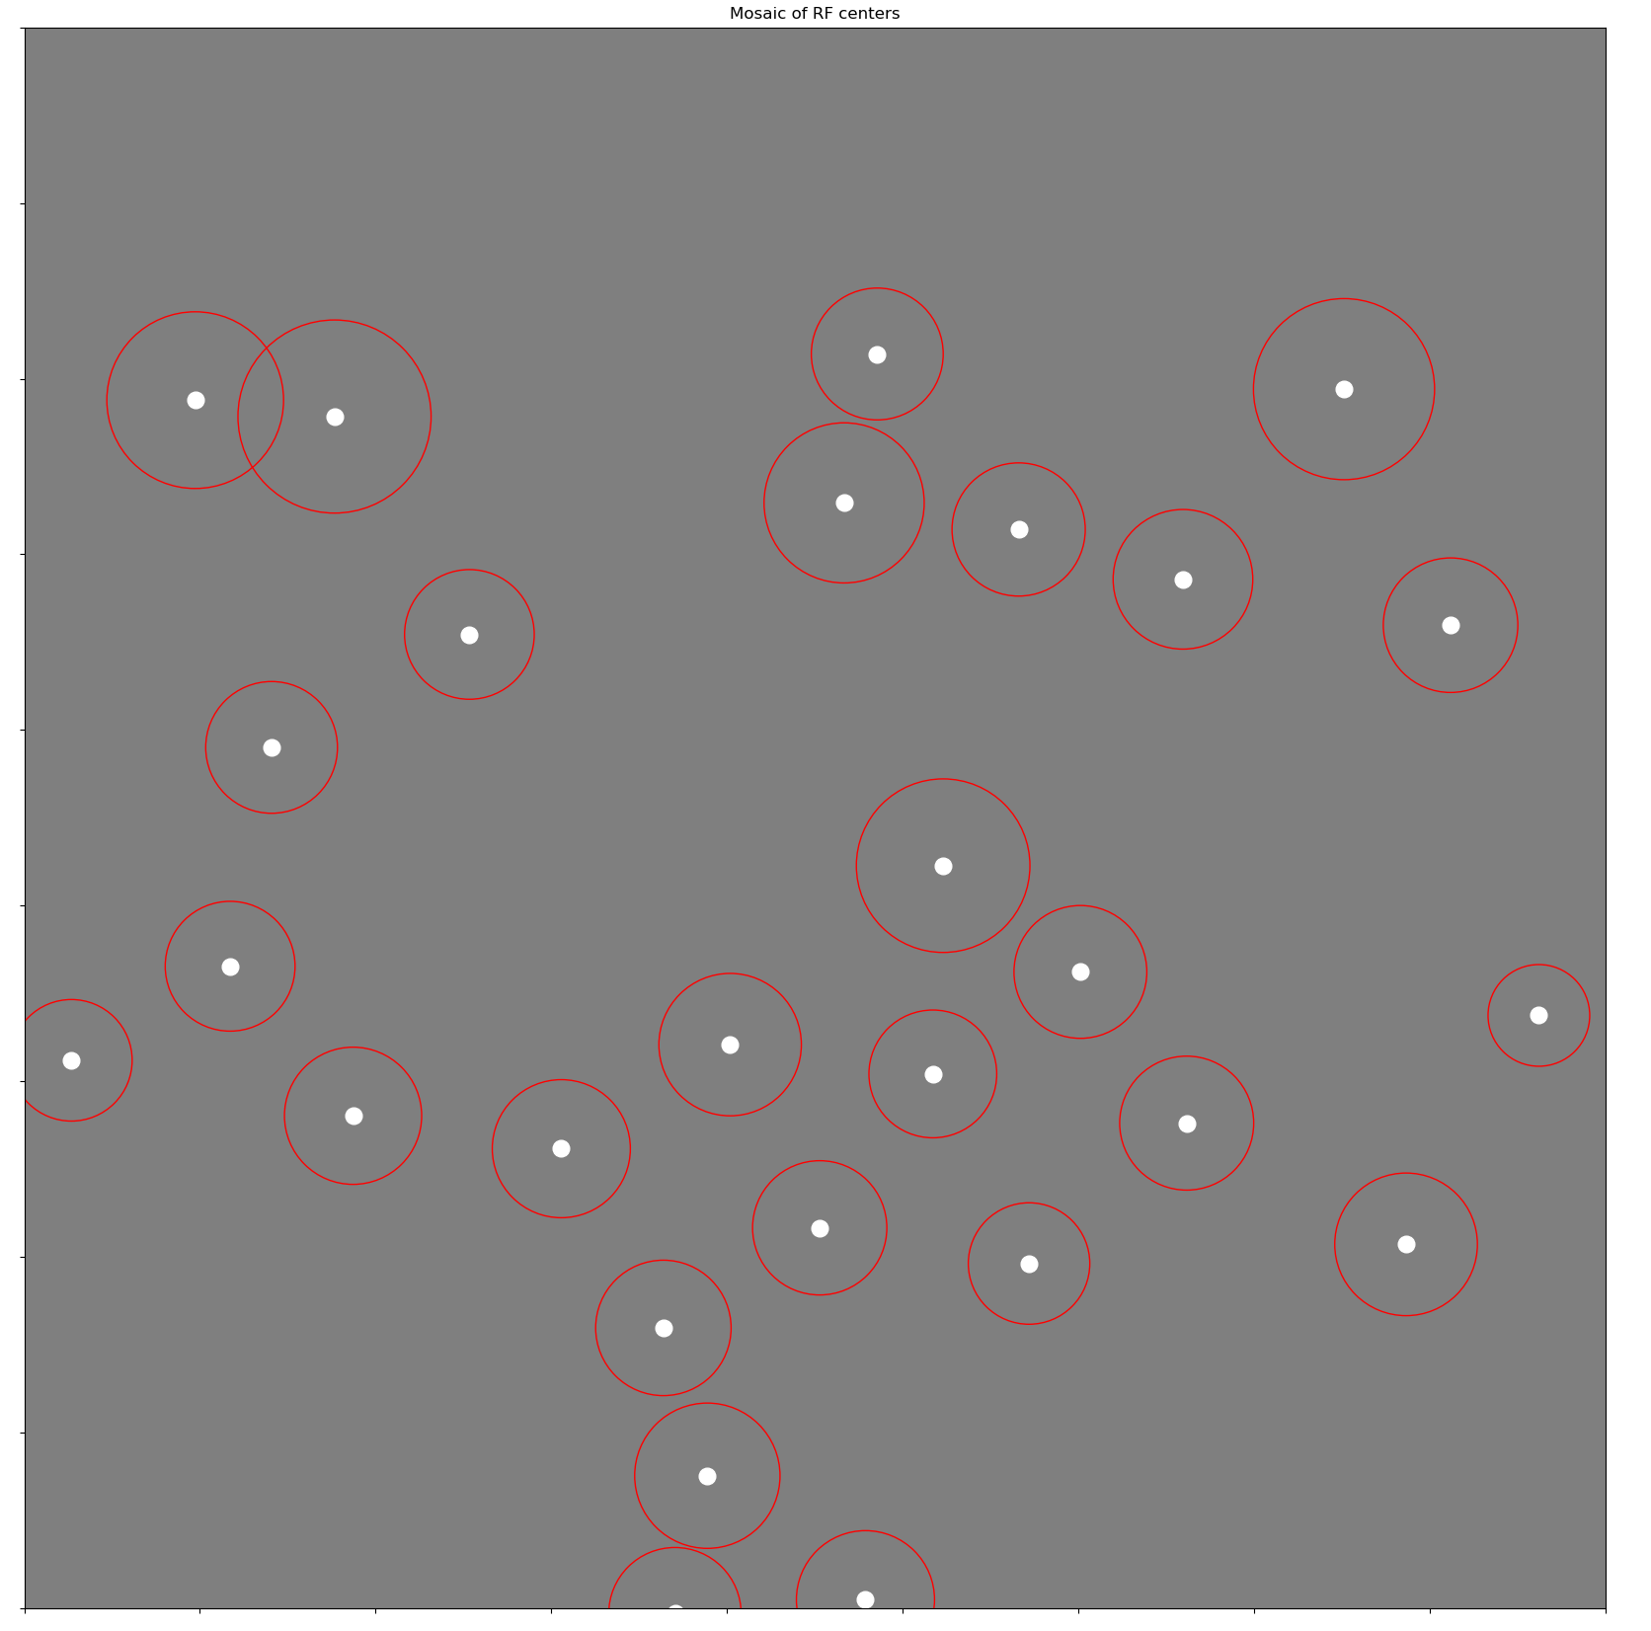
Second type (OFF parvo with –S inputs?)

Slide 28
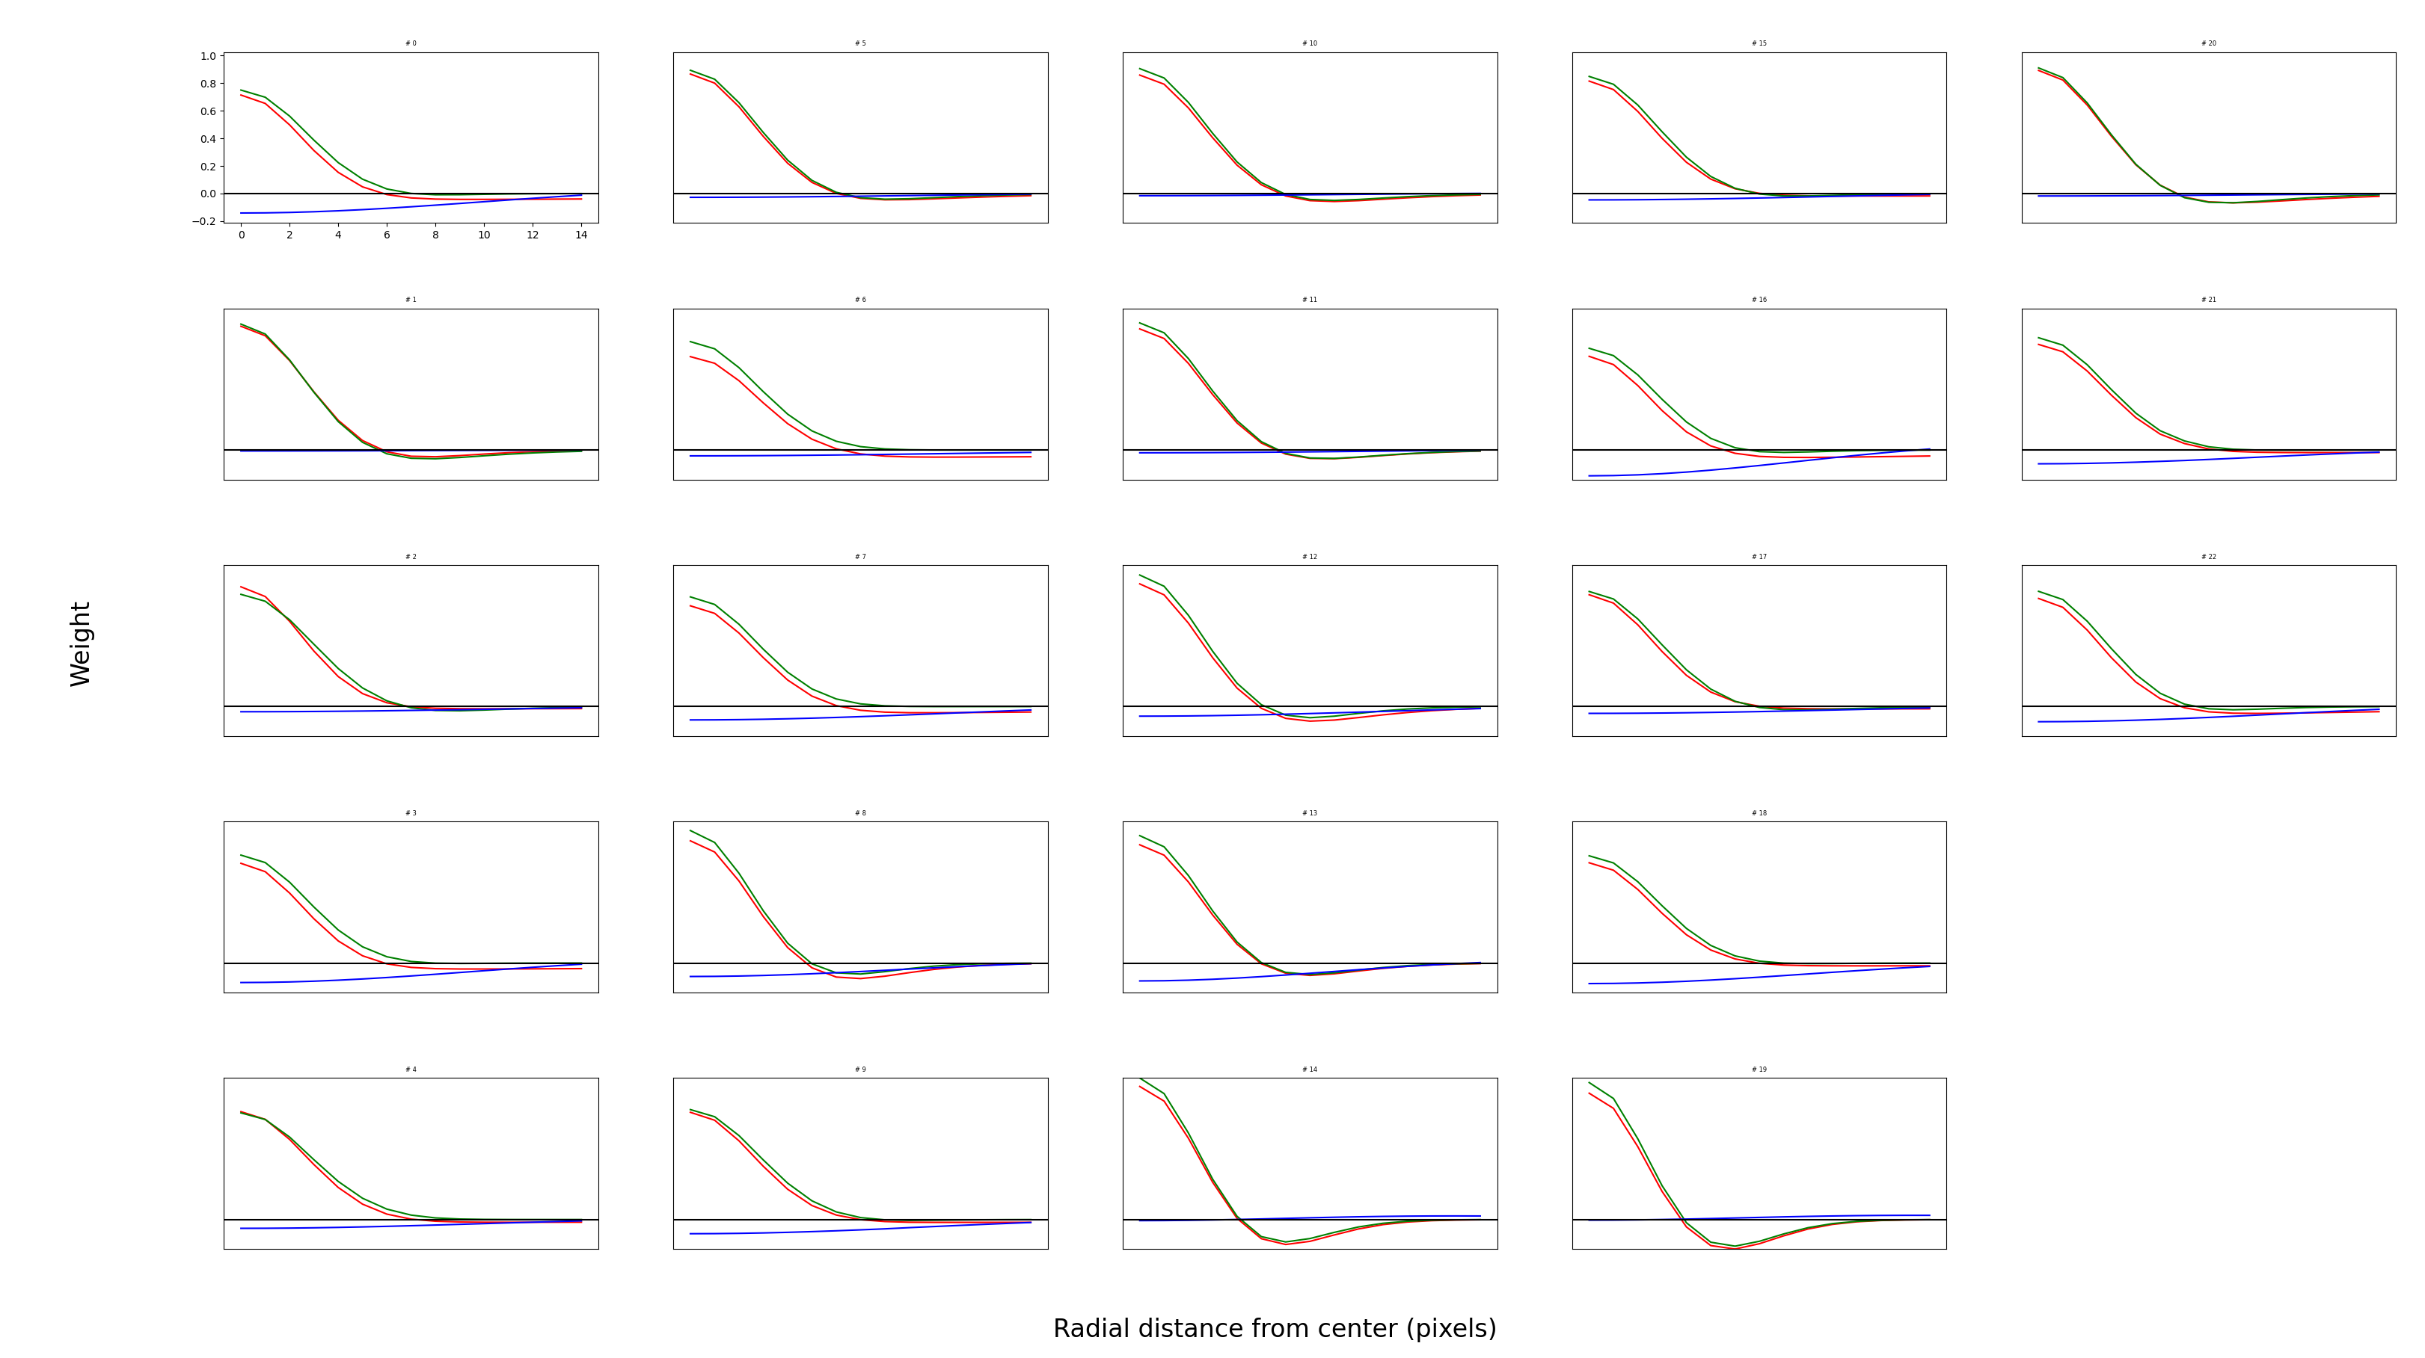
Third type (ON parvo)

Slide 29
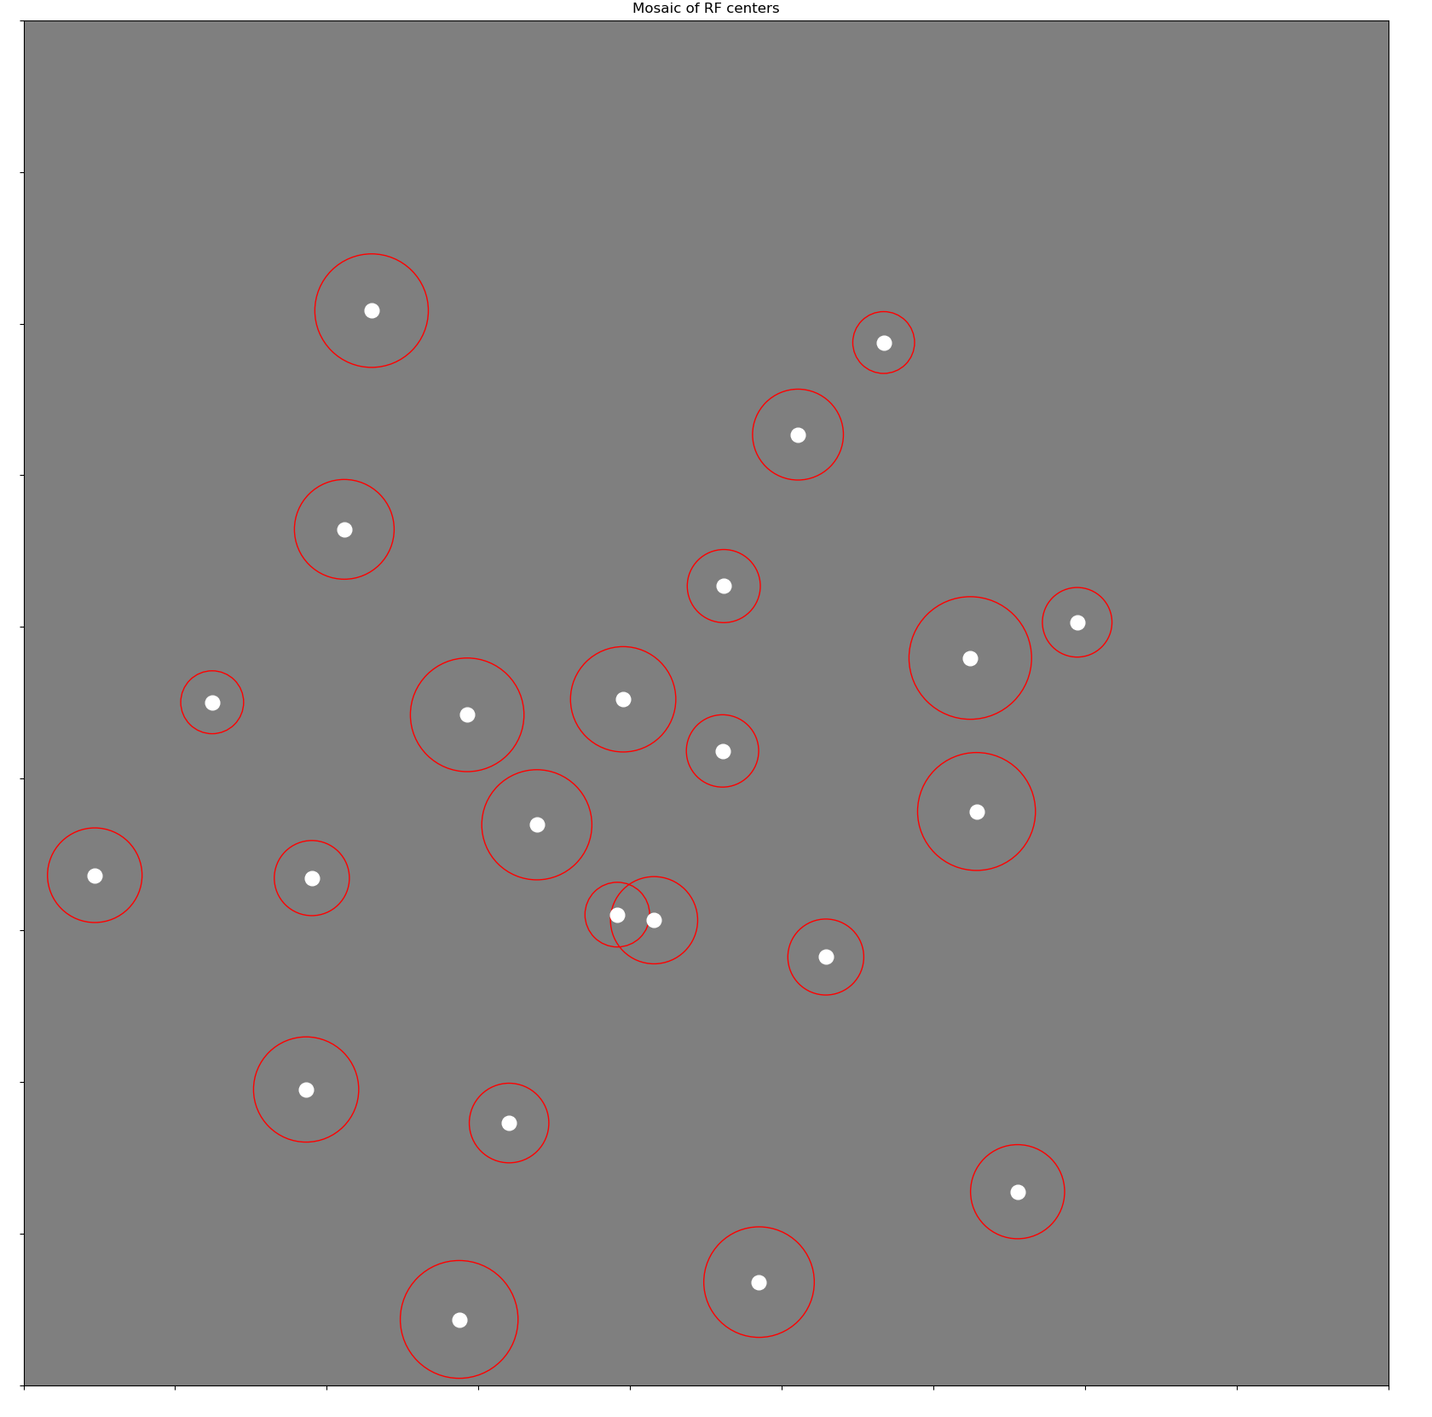
Third type (ON parvo)

Slide 30
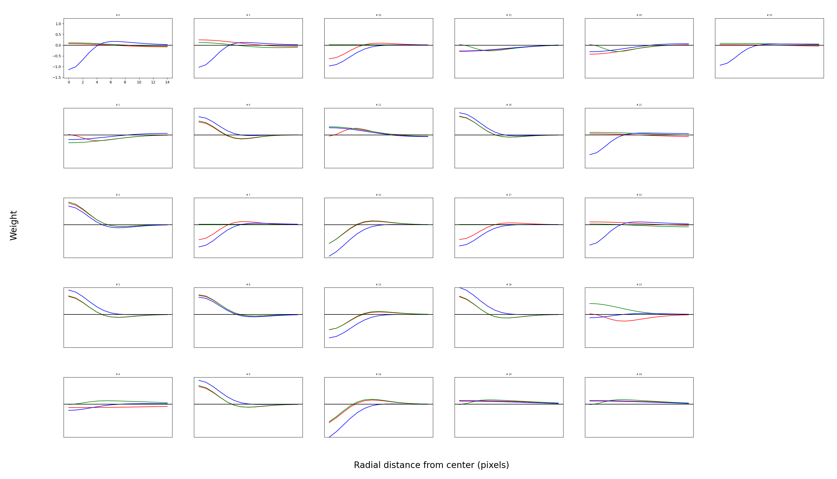
Fourth type (Trash can)

Slide 31
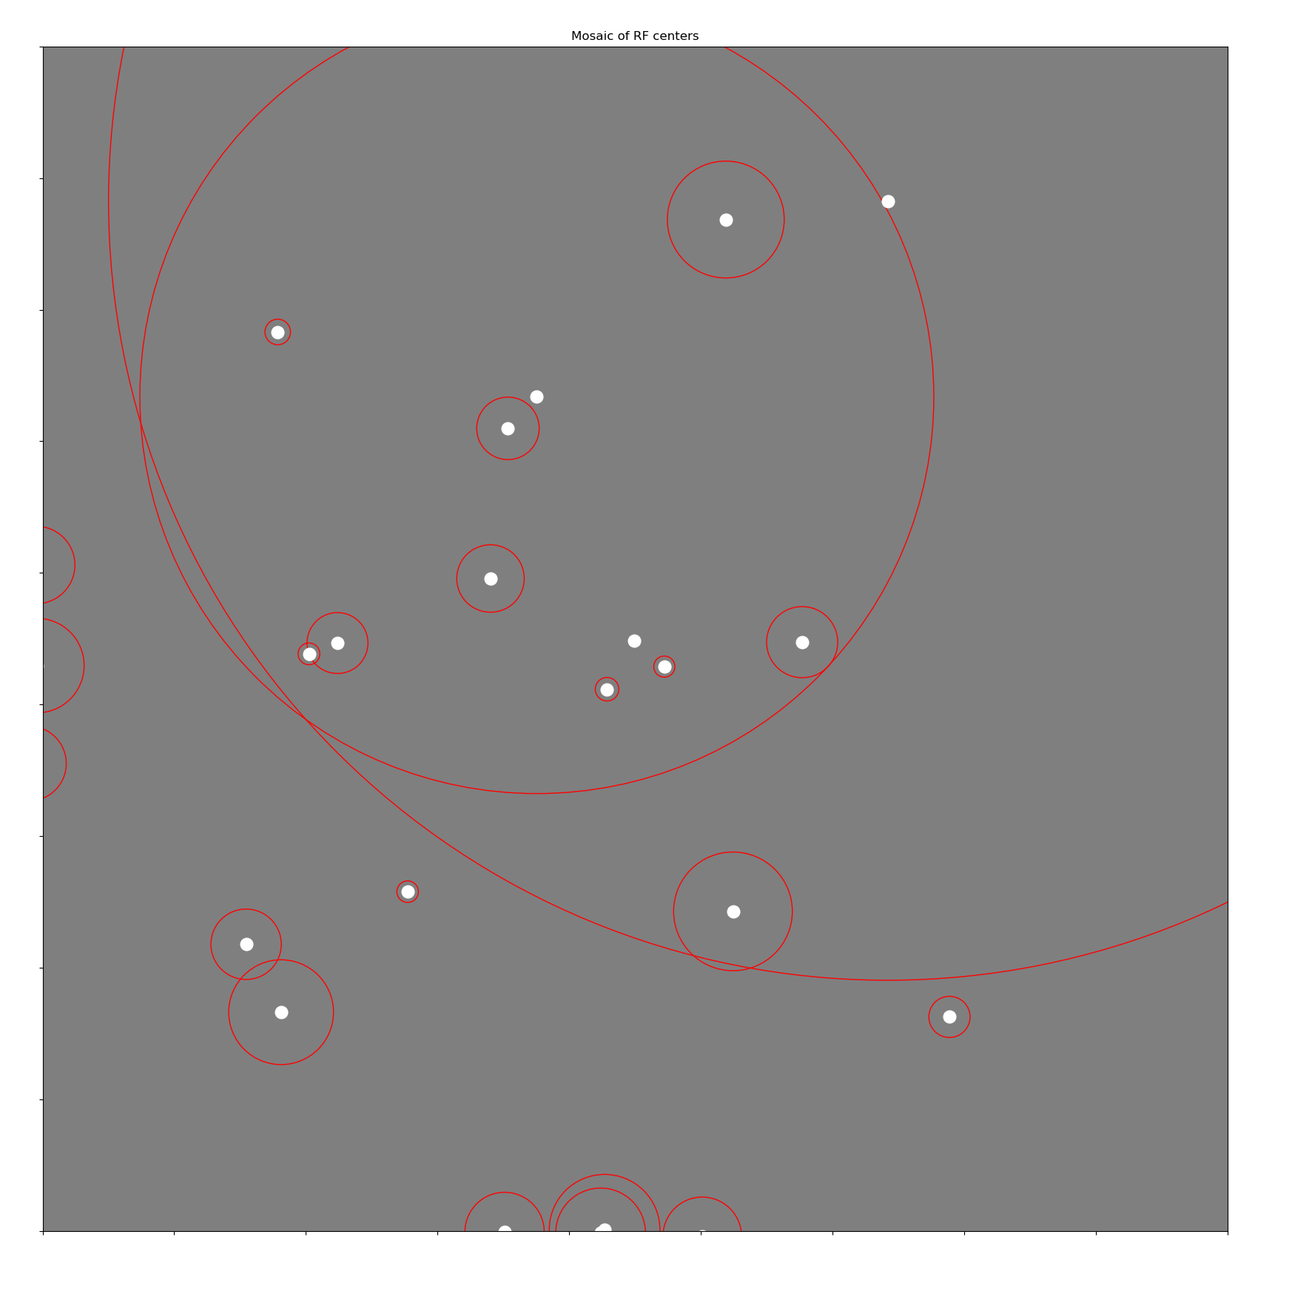
Fourth type (trash can)

Slide 32
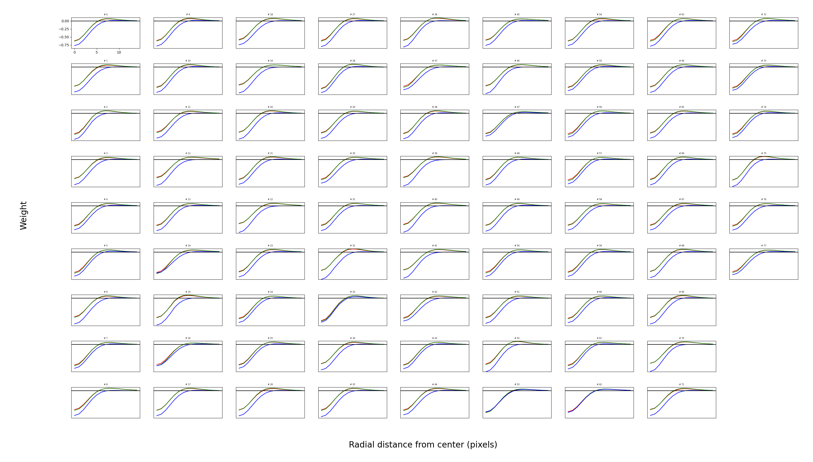
Fifth type (OFF magno)

Slide 33
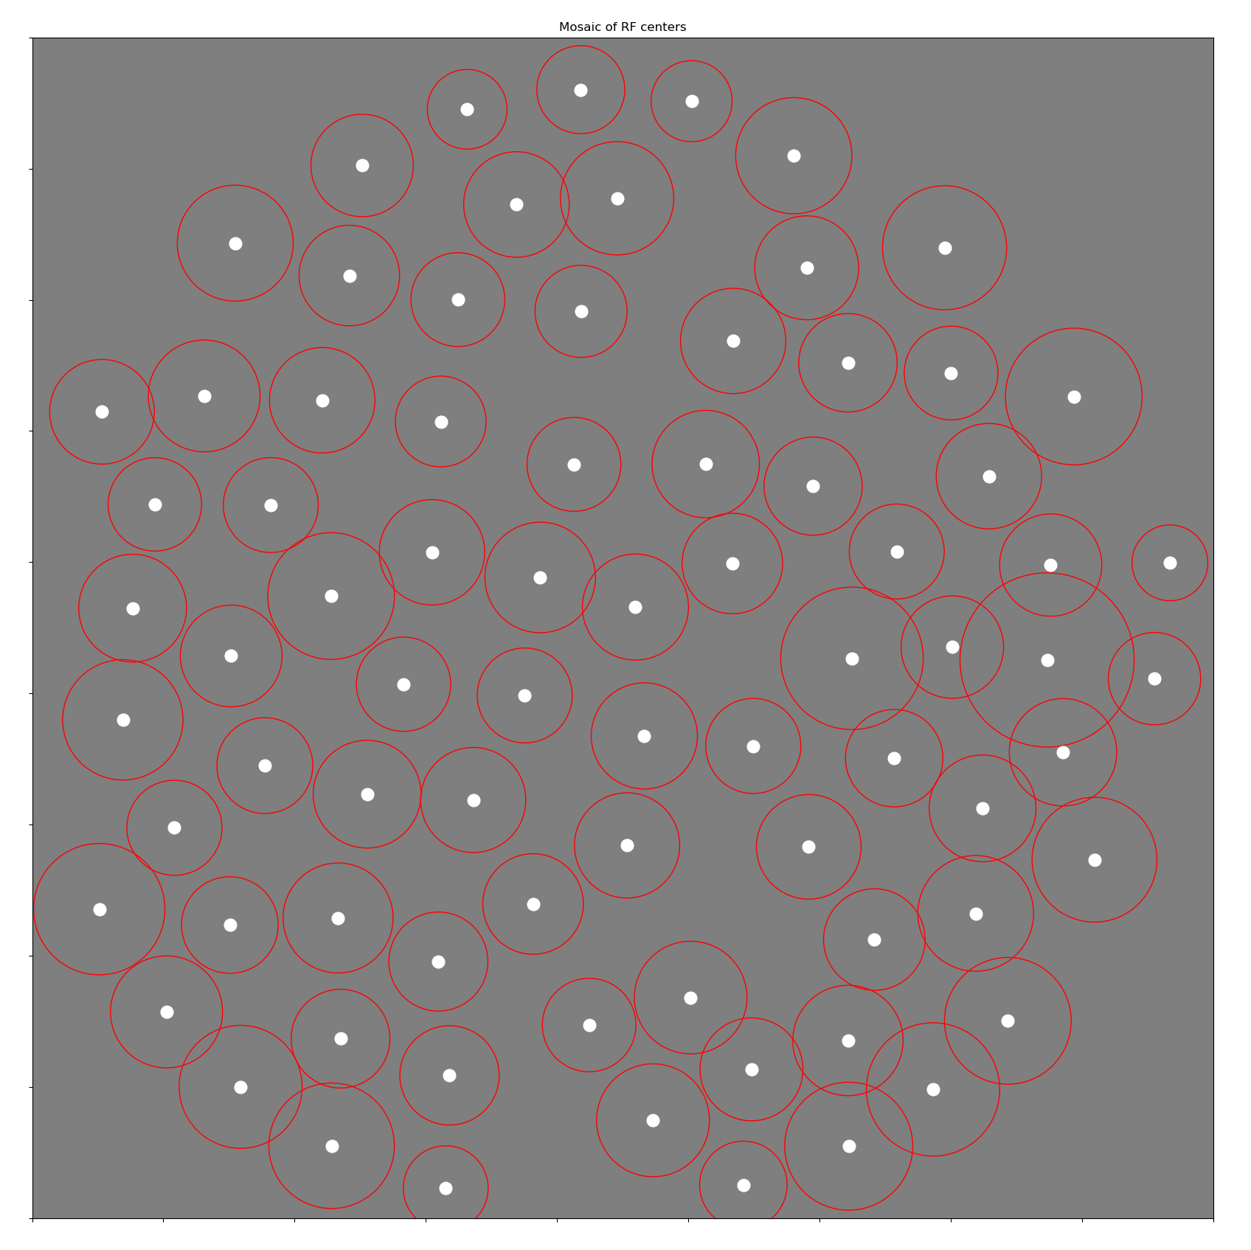
Fifth type (OFF magno)

Slide 34
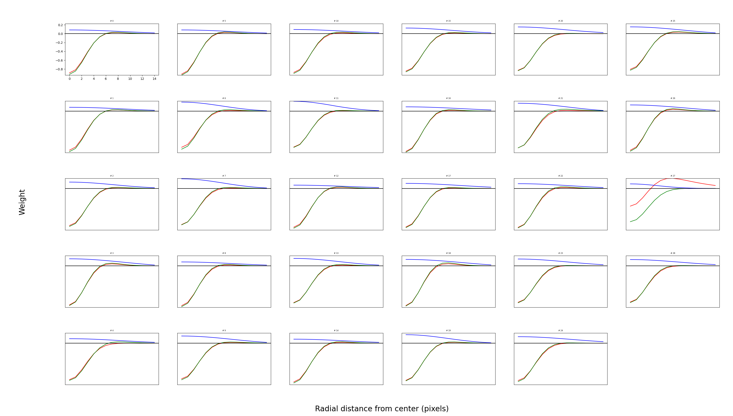
Sixth type (OFF parvo)

Slide 35
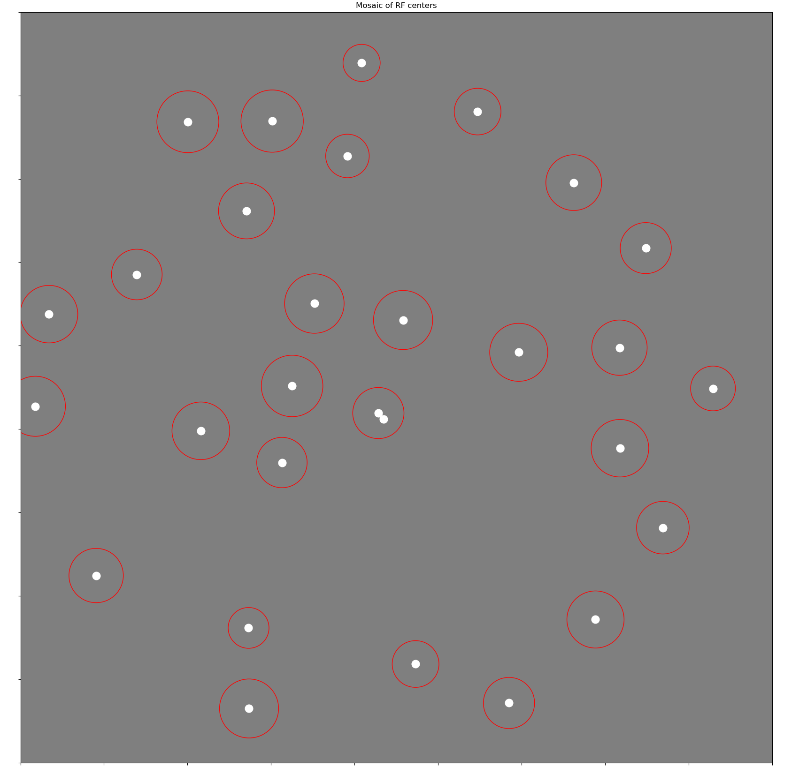
Sixth type (OFF parvo)

Slide 36
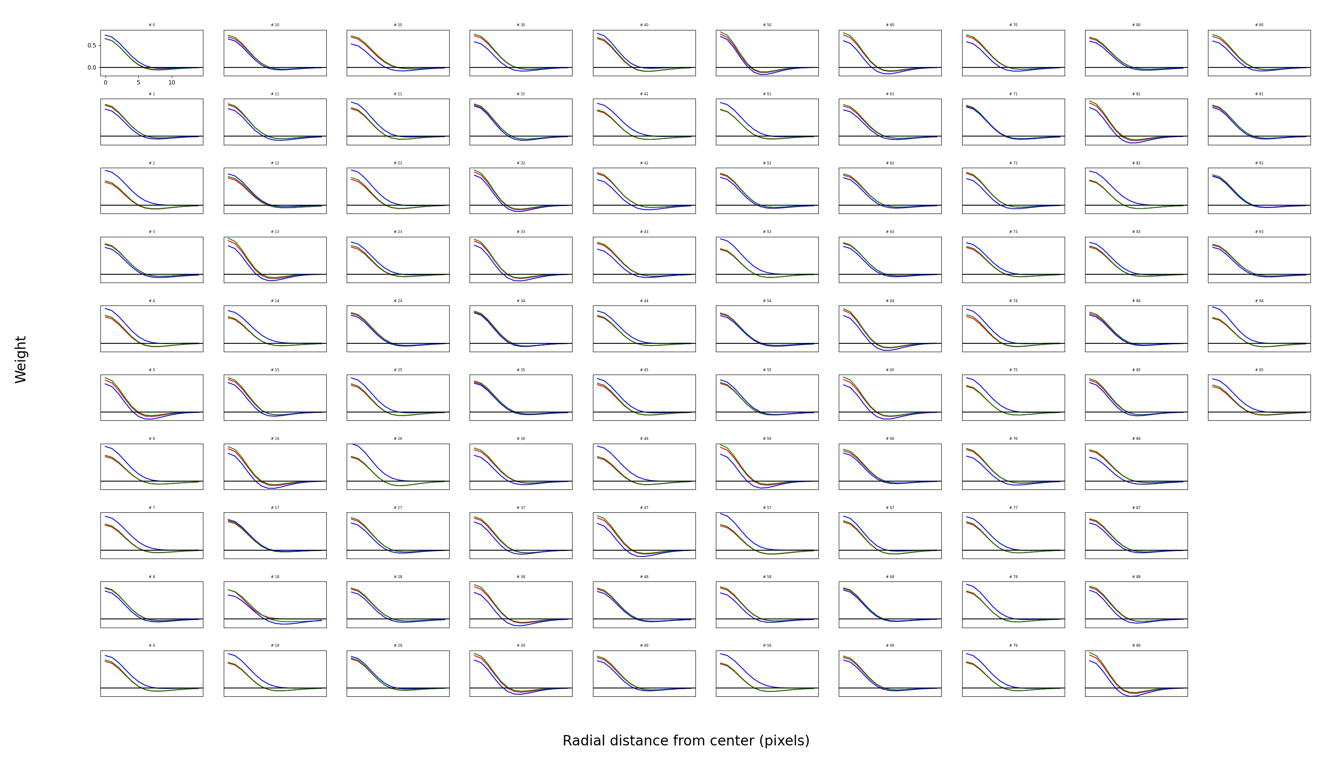
Seventh type (ON magno)

Slide 37
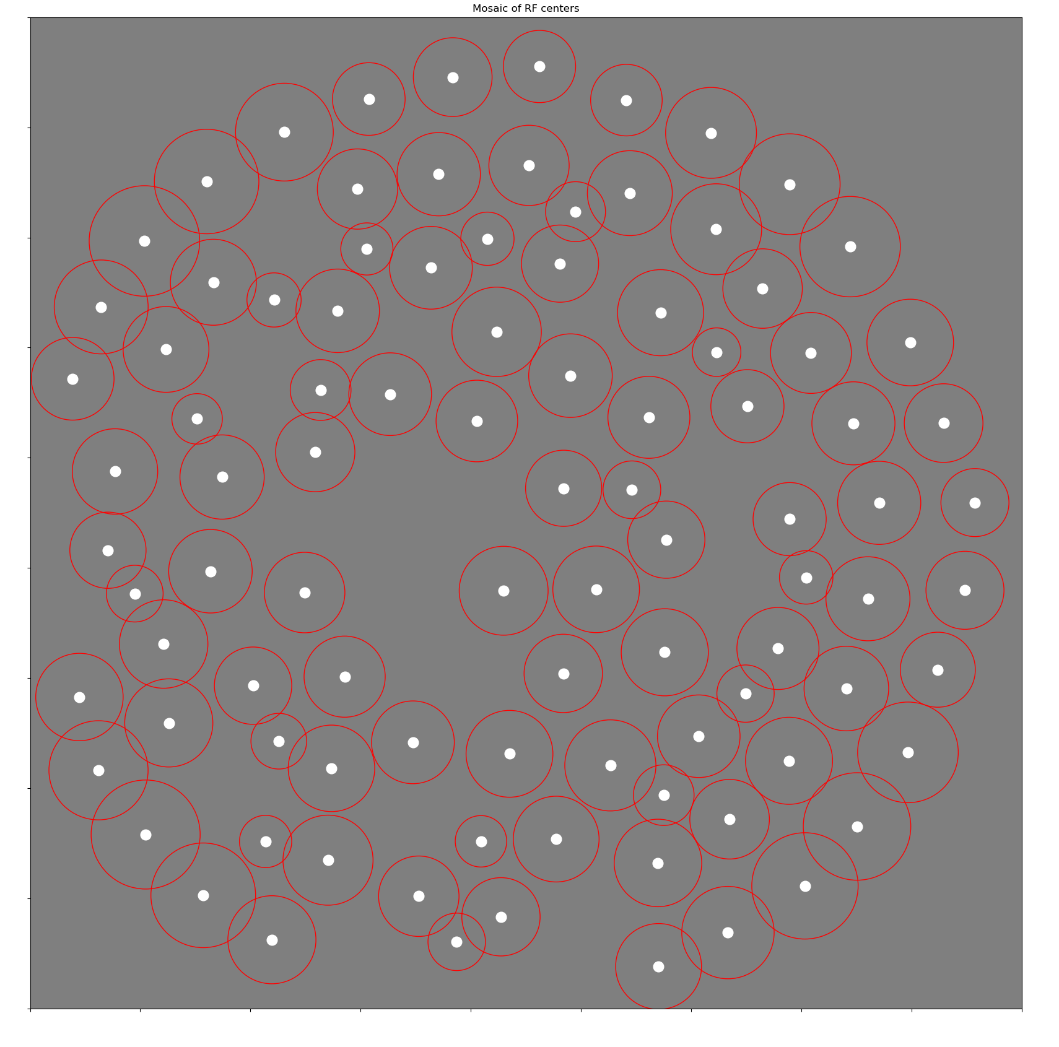
Seventh type (ON magno)

Slide 38
Suggestion
Hypothesis: -S neurons and Trash can neurons contribute less information than the average neuron
MI metric: Remove a single cell from sample and see how much MI decreases.

Slide 39
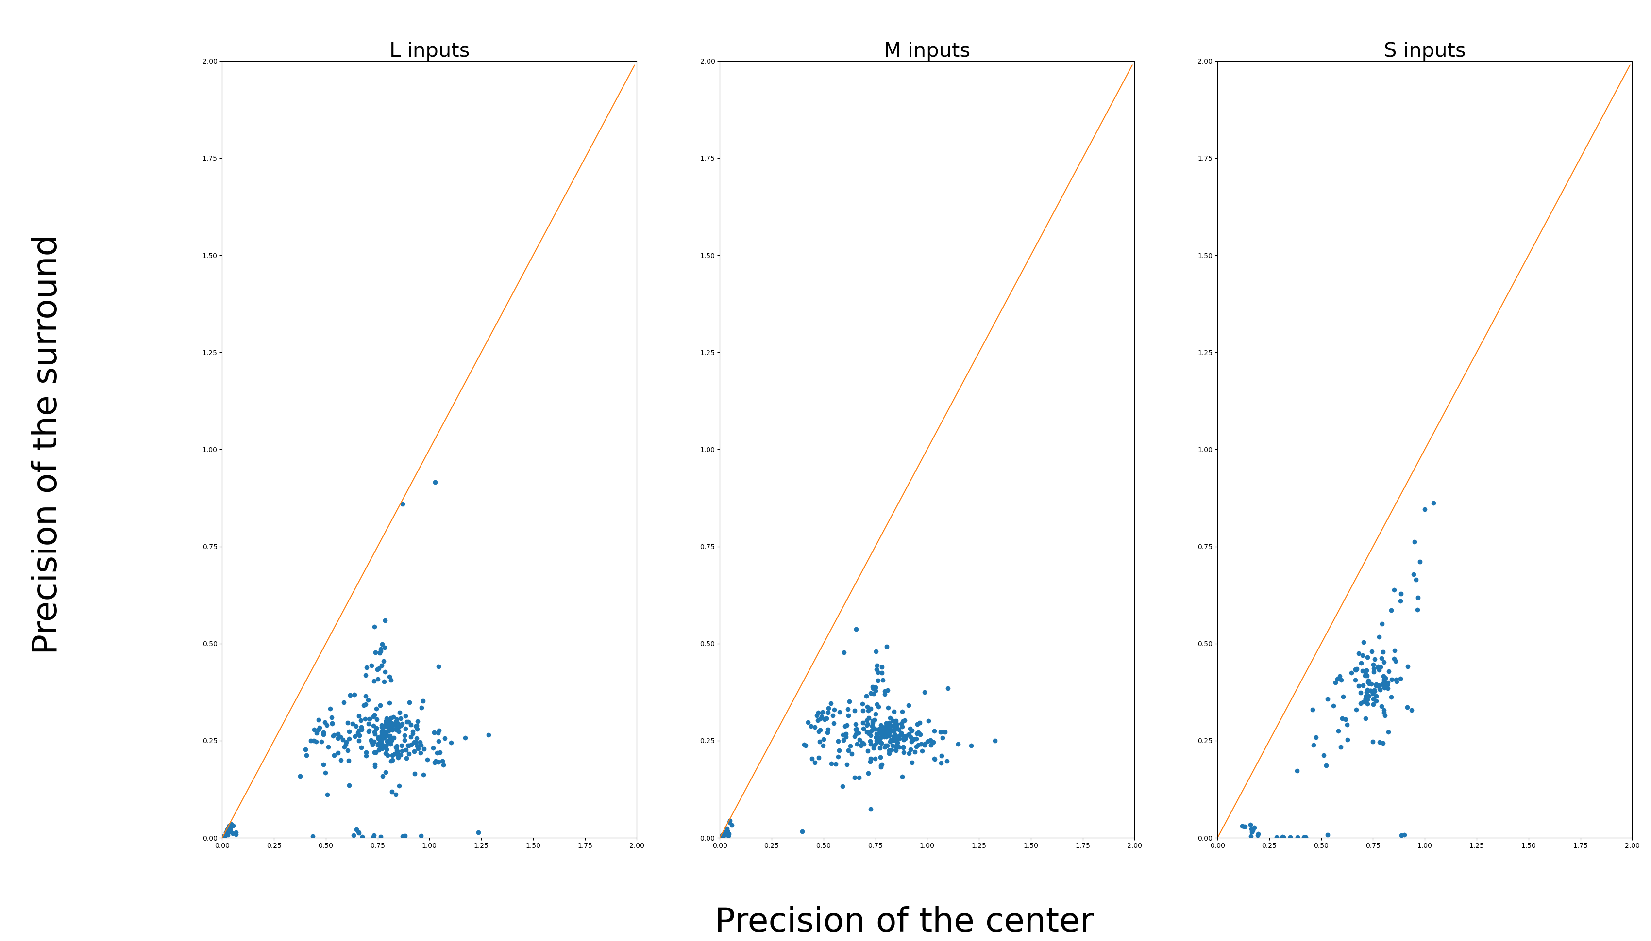
Surround is smaller in S inputs

